Slide 1
Adaptive Storytime: A Community-Based Leadership Project
Kaitlyn Spitler, OTS

Slide 2
Why I Chose This Project
Passion for inclusive early literacy
Interest in OT’s role in early literacy
Gap in accessible community programming
Need for caregiver support strategies
Partnership opportunity with Virginia Down Syndrome Association
Notes:
“I chose this project because of my interest in inclusive early literacy and my desire to better understand and demonstrate occupational therapy’s role in supporting early literacy development. I also identified a gap in accessible community programming for children with developmental disabilities, along with a need for caregiver-friendly strategies that can be used at home. This project provided an opportunity to partner with the Virginia Down Syndrome Association to address these needs in a meaningful and sustainable way.

Slide 3
My Leadership Contributions:
Developed program curriculum
Partnered with Virginia Down Syndrome Association
Led and facilitated sessions
Created caregiver education materials
Evaluated program outcomes
Notes:
“I led all phases of this project, including program design, collaboration with the Virginia Down Syndrome Association, implementation of sessions, and evaluation of outcomes.”

Slide 4
Adaptive Storytime Model
Pilot program
Tailored to children ages 0-8 with Down syndrome or other I/DDs
Multi-sensory storytelling
Movement-based activities
Structured routine
Caregiver involvement
Notes:
“The program used a structured but flexible format, incorporating multi-sensory strategies, movement, and caregiver participation to support engagement and learning.”

Slide 5
*weekly routine example
Welcome to the VDSA
Adaptive Storytime
February 7, 2026

Slide 6


Slide 7
Time to Play!

Slide 8


Slide 9
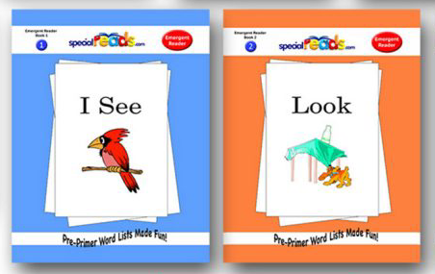
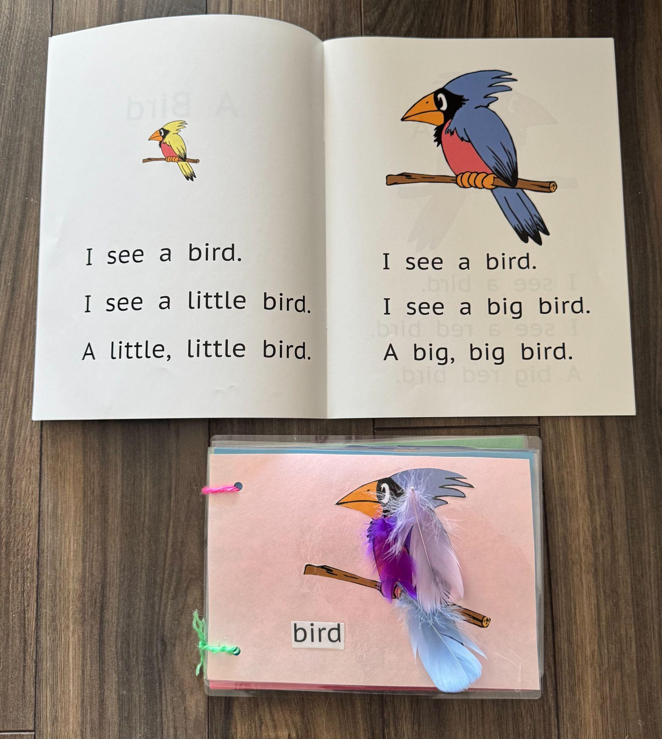
Let’s Read!

Slide 10
Motor Skill Fun!

Slide 11


Slide 12
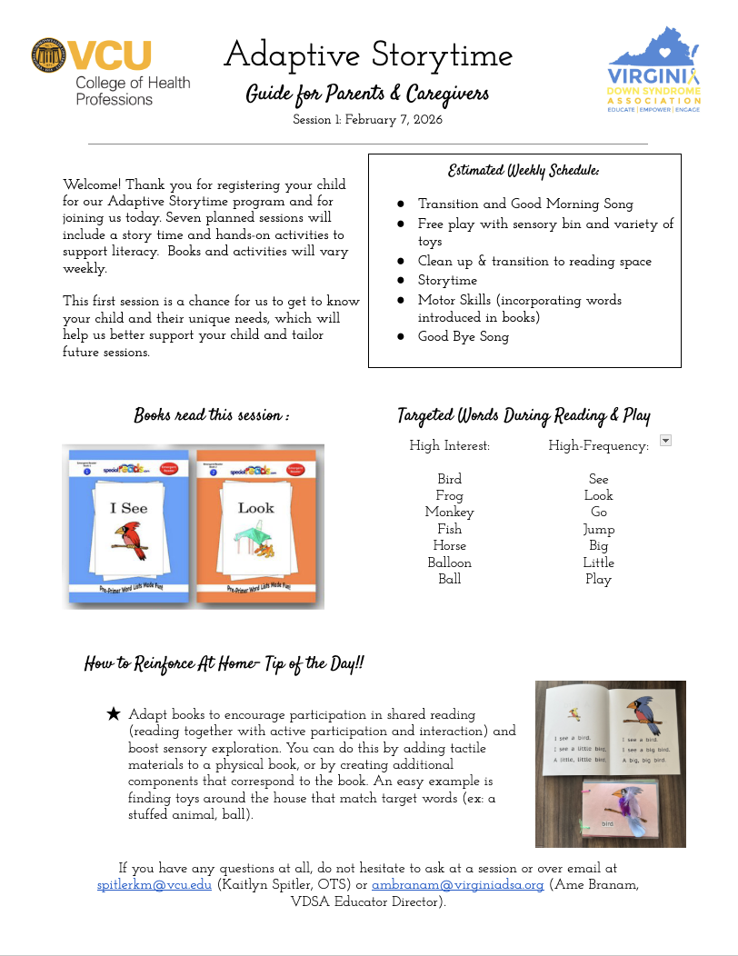
Weekly Handouts
Reviewed weekly routine, books, and targeted words during reading & play
Included “How to Reinforce at Home- Tip of the Day!” to encourage home carryover and boost caregiver confidence

Slide 13
Outcomes
What Families Valued Most:
Social Interaction
Hands-on engagement
  “Hands-on approach kept my child’s attention longer”
Inclusive Enviornment
Communication Development

Slide 14
Future Impact
Expand access to inclusive literacy programs for children with disabilities 0–21 and their families
Serve as a replicable model for occupational therapists, additional professionals, and community organizations
Enhance child engagement, social participation, and communication development
Empower caregivers with strategies and confidence to support early literacy at home

Slide 15
Thank you!

