Slide 1

Virginia LEND Leadership Project:
Community Engagement & Partnership Development at Hilltop Home, Raleigh, NC
Domenica Pusic, OTS
Spring, 2026

Slide 2
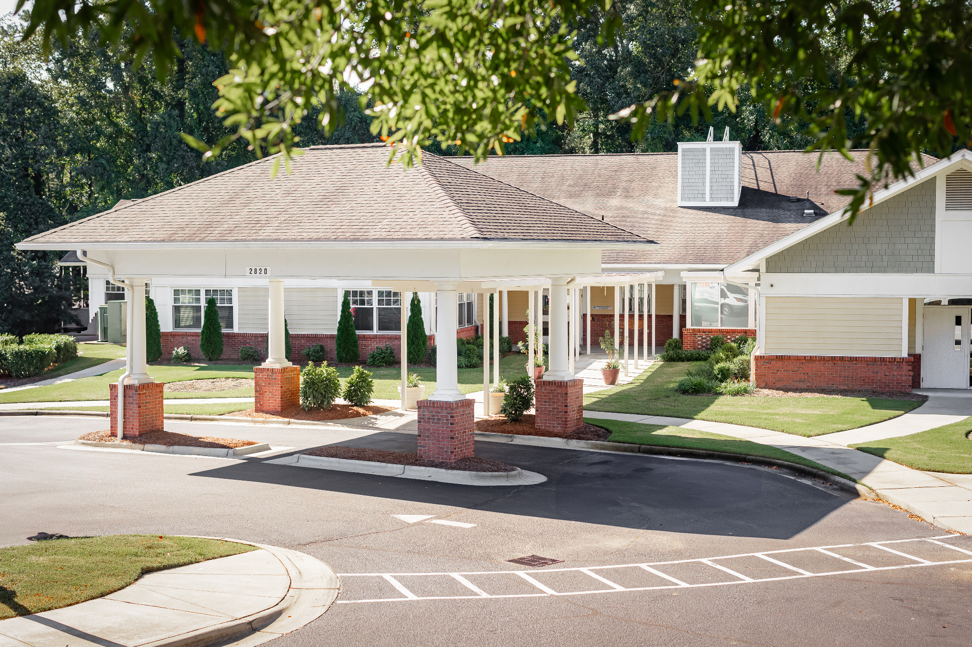
What is Hilltop Home?
Hilltop Home is a private, nonprofit Intermediate Care Facility in Raleigh, North Carolina that serves children with severe to profound developmental disabilities who are medically fragile. From birth through adulthood, Hilltop Home tailors care to each individual’s medical, developmental, and educational needs.
Hilltop Home offers comprehensive services including around-the-clock licensed nursing care, personalized medical support, therapeutic services, and a certified educational program. Their multidisciplinary team collaborates to create habilitative care plans while partnering with families, donors, and the community to enhance quality of care, promote social and emotional well-being, and encourage meaningful participation in activities throughout the Raleigh community.

Slide 3
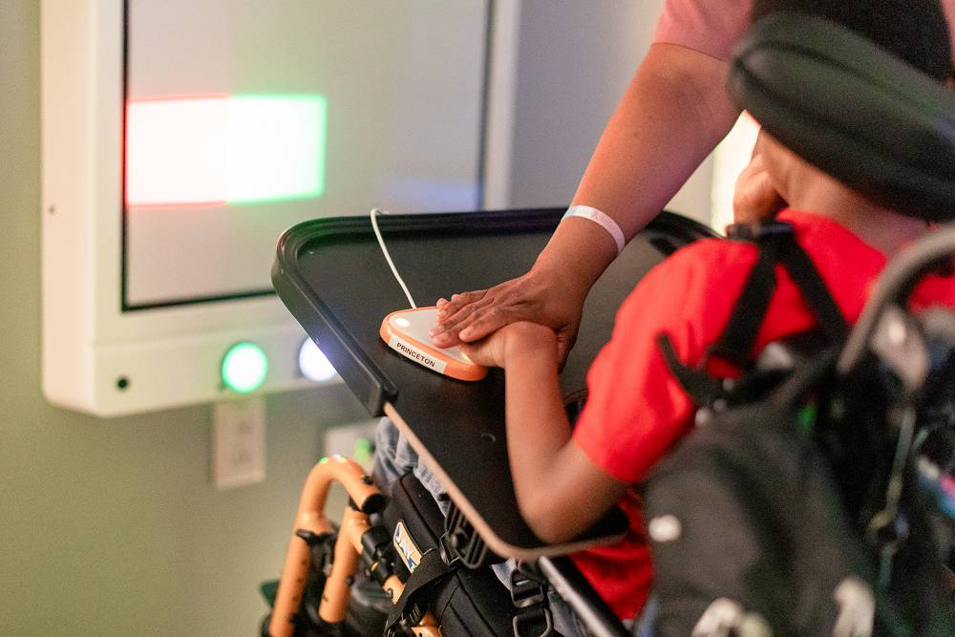
For 60 years and counting, Hilltop Home’s mission is to provide exceptional, individualized, 24/7 care in a nurturing, home-like environment, grounded in the belief that every child deserves safety, dignity, love, and opportunities to thrive.

Slide 4
The Need:
Hilltop Home stated their desire to increase community partnerships in the Raleigh, NC area to enhance social participation and activity engagement of the residents of Hilltop Home.
Action Items:
Creating an updated resource educating the community on the purpose of the Hilltop Home and benefits of community engagement with the facility’s residents
Providing information on how the community can engage, volunteer, and/or donate to Hilltop Home to support
Stakeholders discussed the common issue of community members not an understanding the limitations of the residents and the role confusion of being a volunteer versus helping with daily living tasks.

Slide 5
Supporting Research
There is a lack of evidence regarding social participation and community engagement with medically complex and fragile children, but statements regarding the general benefits of community engagement with children with complex and chronic needs can apply:
“Community engagement has been effectively implemented to improve pediatric outcomes” (Mitchel et. al., 2023).
“For children, community plays an important role in their development and builds skills like resilience, communication, empathy, and cultural understanding” (Hanigan, 2024).
“Community engagement promotes positive, enduring change for children, families, and communities…” (Communities, 2026).
“Families, particularly those with very young children or with special health care needs, often face barriers to participating in community feedback activities” (Canonico, 2021).

Slide 6
Steps to Pursue Community Engagement and Partnership
Stakeholder interviews with Hilltop Home’s occupational therapist and case manager (formally titled “Qualified Intellectual Disabilities Professional”)
Learned about need for increased community engagement and programming for the residents
Received approval from LEND mentor
Specified project to creating a resource to educate the community about the Hilltop Home, how they can volunteer or partner, benefits of engagement, and updating their donation items list
Created brochure and flyer relaying volunteer information; received initial feedback from the Hilltop Home program director and office manager prior to final draft
Created a survey to be sent to facility staff for input on updated donation items; compiled survey findings to a single document for facility to add to their Amazon Wishlist

Slide 7
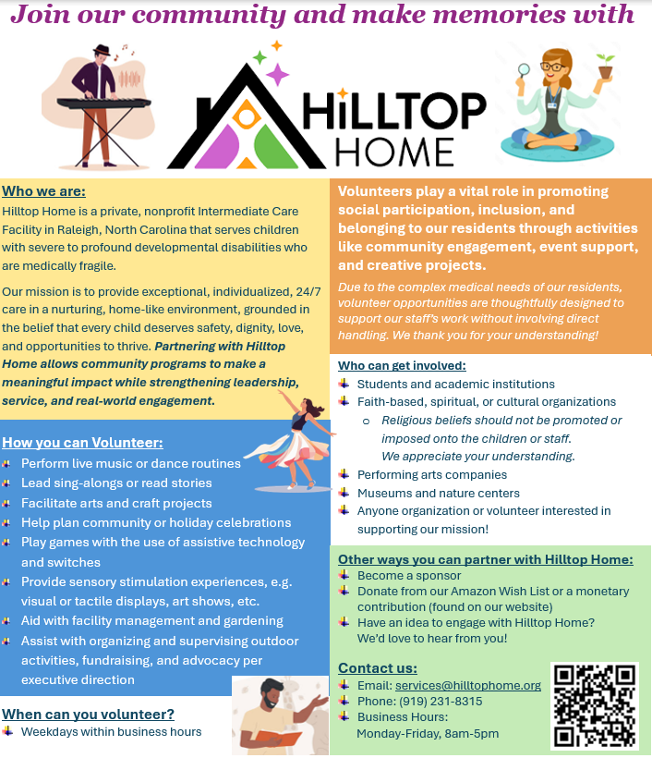
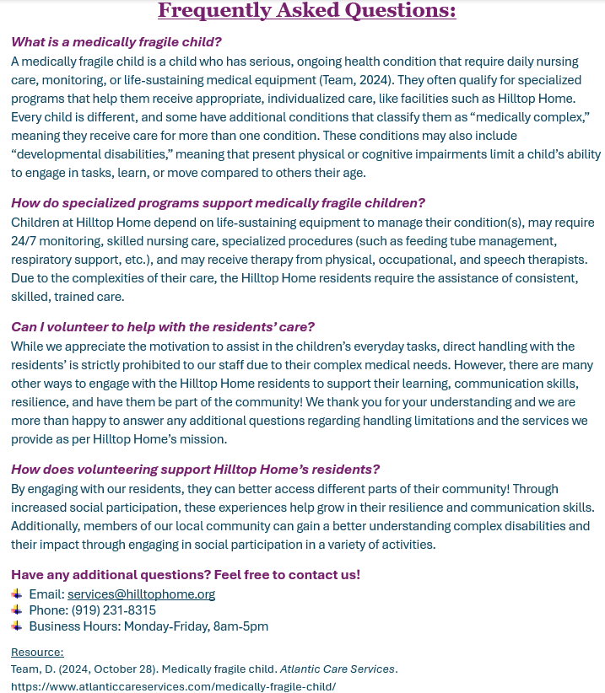

Slide 8
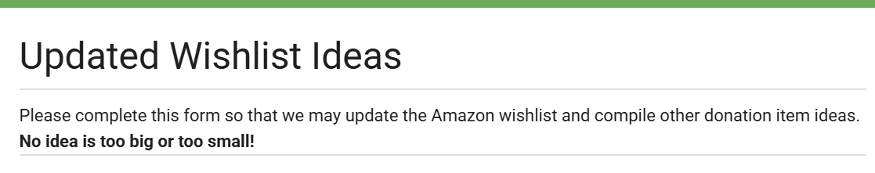
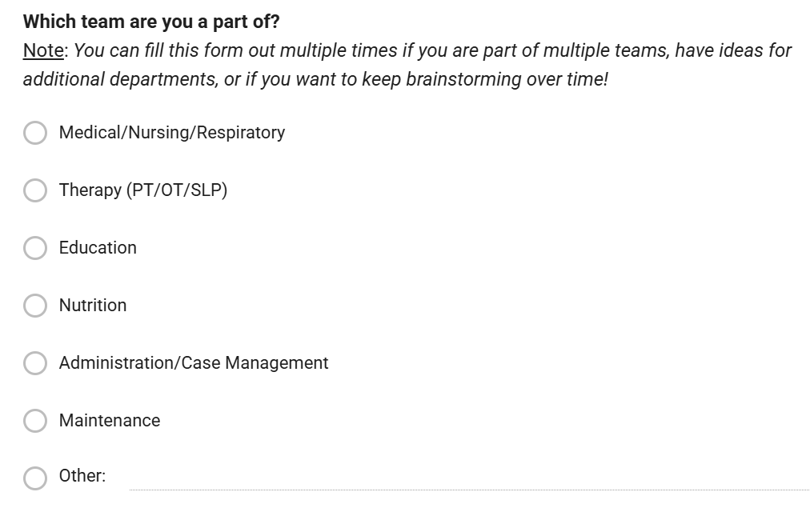
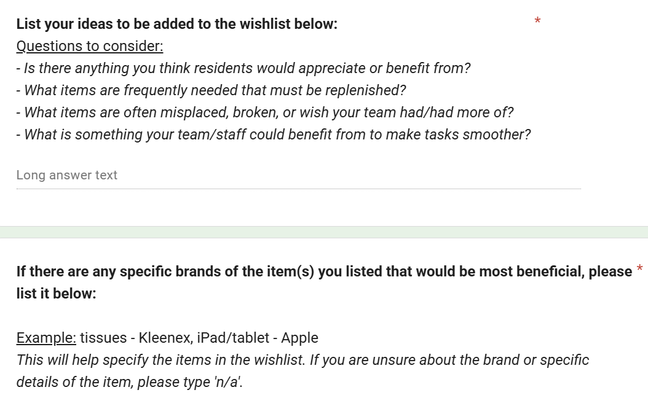
Expanding Donation Opportunities
Notes:
Important due to nonprofit org, high medical needs of residents, majority of needs related to accessible games, supplies for education classes, and ADL items (e.g. toiletry items)

Slide 9
Steps to Pursue Community Engagement and Partnership
3. Printed and distributed resources to +200 establishments/organizations of the Raleigh, NC area:
Religious/spiritual communities
Performing arts organizations
Music, drama, art, dance, etc.
Nature centers
Museums
Schools
High schools and local universities, specifically to engineering, arts, and humanities departments

Slide 10
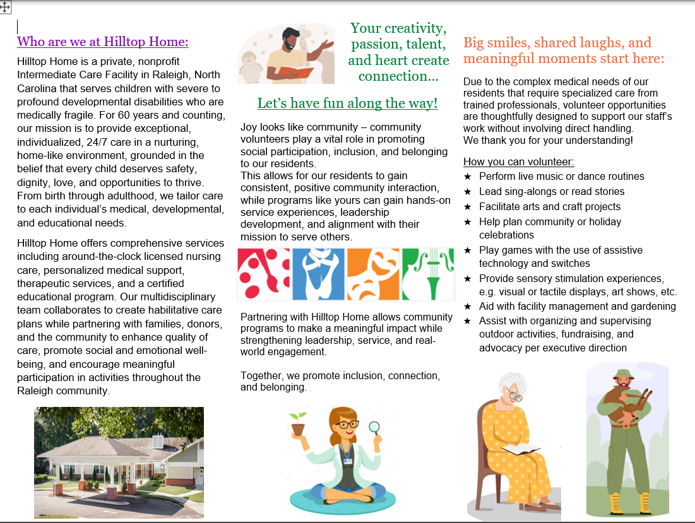

Slide 11
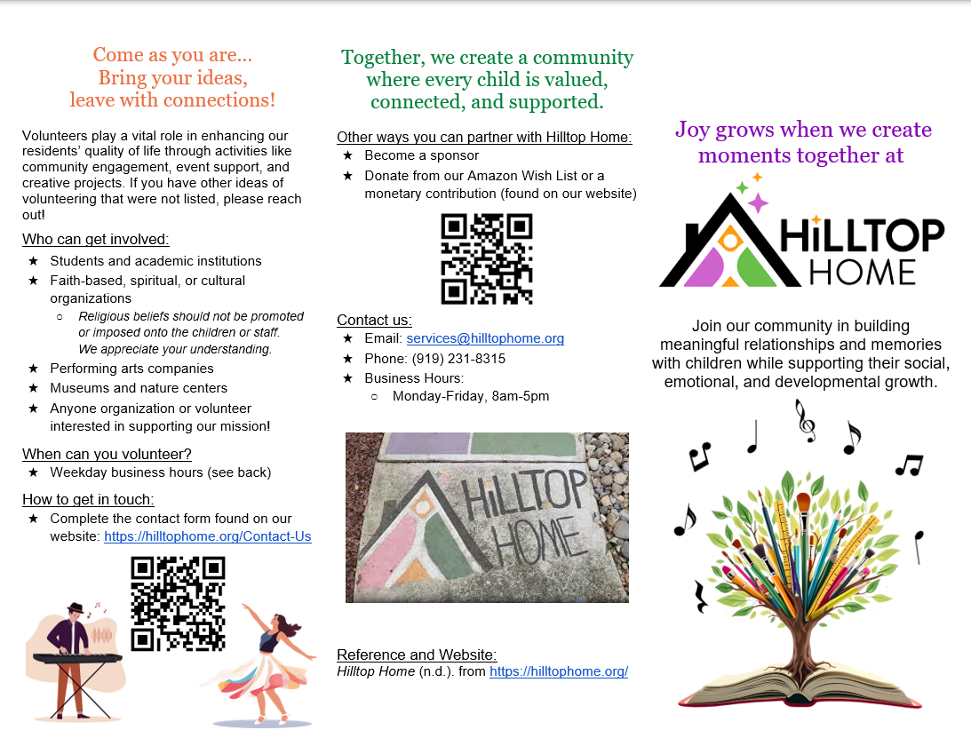

Slide 12
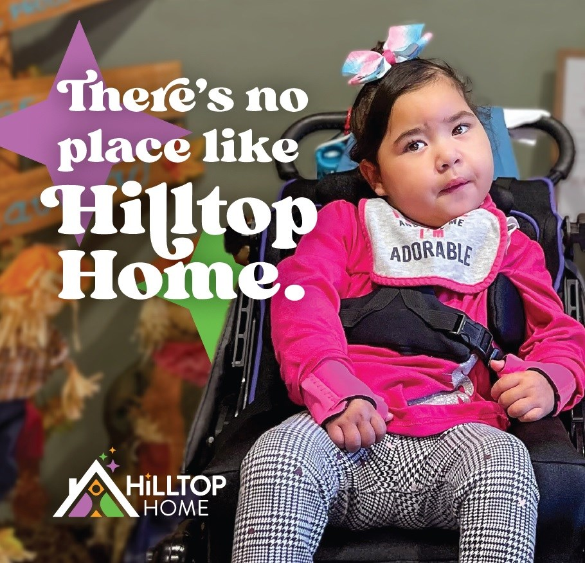
Goals and Summary
Upon the distribution of community engagement resources to the Raleigh community on various ways to partner, volunteer, and donate:
Residents of Hilltop Home can engage more with their community
Increased engagement with community members can help residents’ grow in their resilience and communication skills
Members of the Raleigh community can gain a better understanding of the importance of facilities like Hilltop Home and the importance of engagement with the children they serve

Slide 13
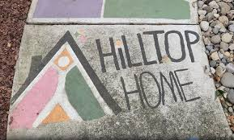
References
Canonico, M. (2021, September 2). Engaging families in program and policy development to ensure equitable health outcomes for children—Chcs blog. Center for Health Care Strategies. https://www.chcs.org/engaging-families-in-program-and-policy-development-to-ensure-equitable-outcomes/
Community engagement | headstart. Gov. (n.d.). Retrieved March 24, 2026, from https://headstart.gov/community-engagement
Hanigan, A. (2024, October 31). Community as medicine: How to build and benefit from community for your child and yourself. CHOC - Children’s Health Hub. https://health.choc.org/community-as-medicine-how-to-build-and-benefit-from-community-for-your-child-and-yourself/
Hilltop Home (n.d.). from https://hilltophome.org/

