Slide 1



Caregiver Resilience in the NICU
Victoria King, PT, DPT
VCU LEND Leadership Project ‘25-’26

Slide 2
Why?
What makes this topic special to me?
Interest in NICU care and caregiver experiences
Passion to support caregivers in the NICU environment
Strengthen the role of multidisciplinary team (particularly physical therapists) in family centered care in the NICU environment

Slide 3
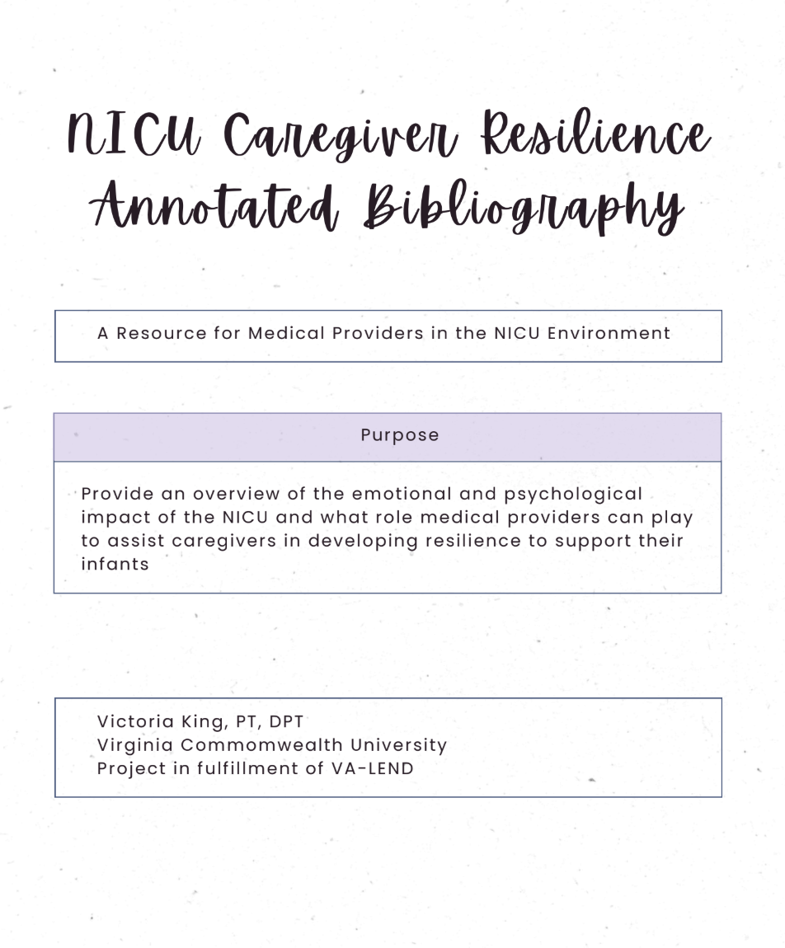
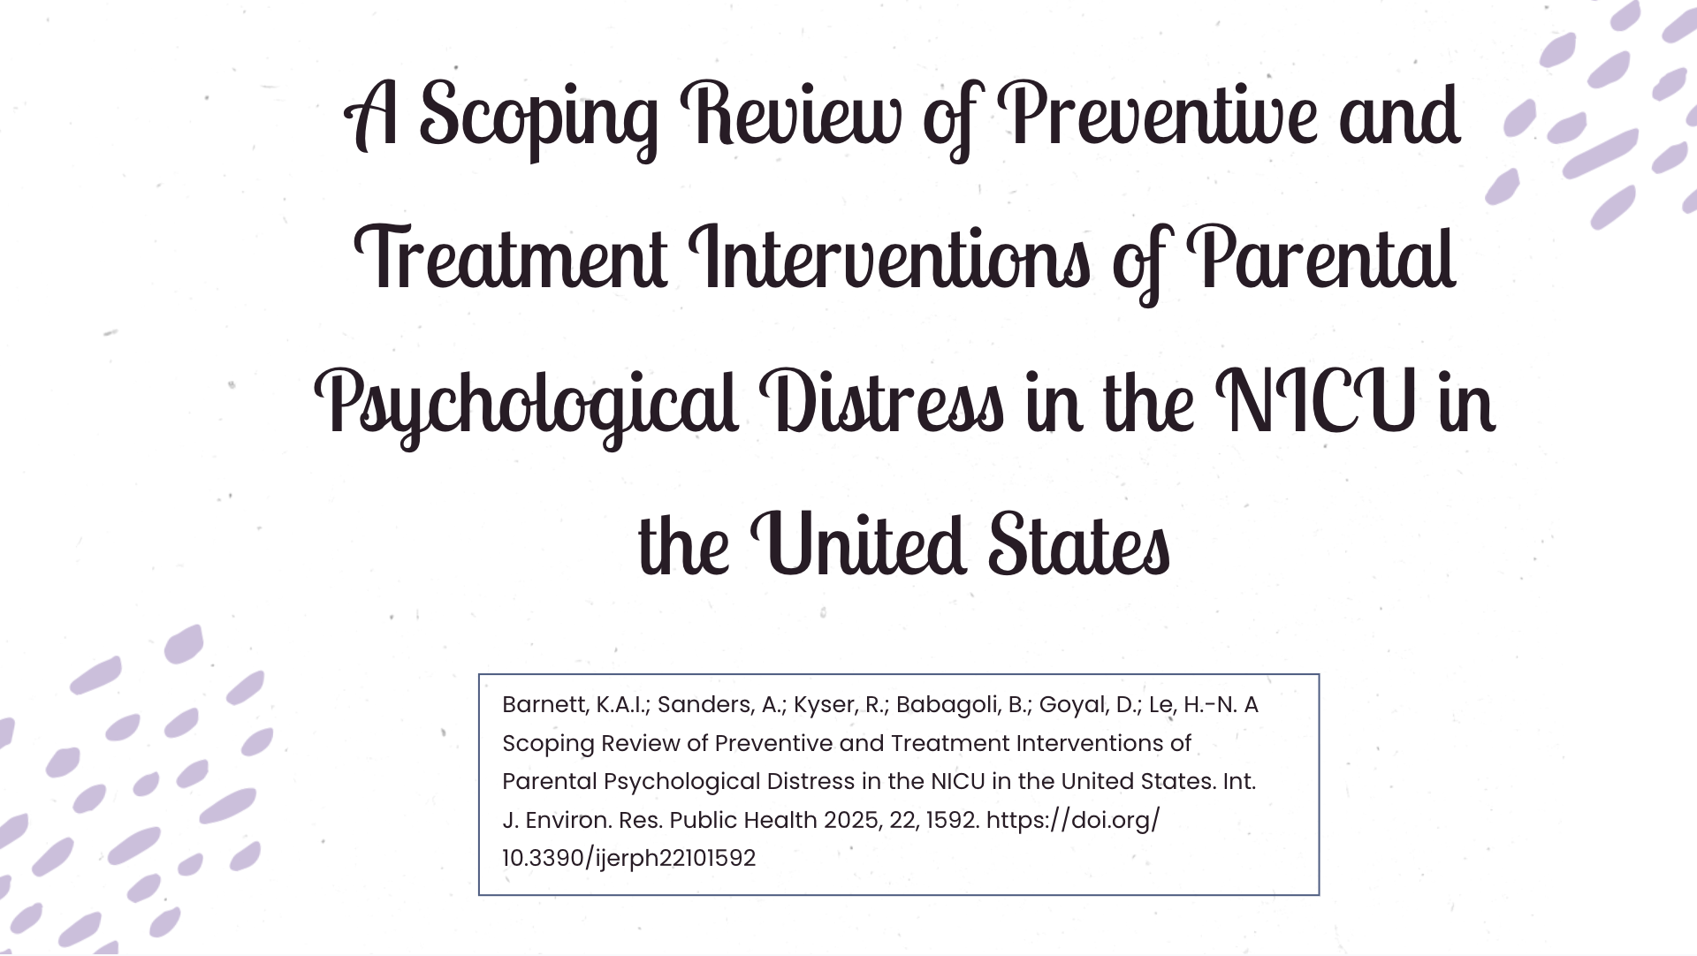
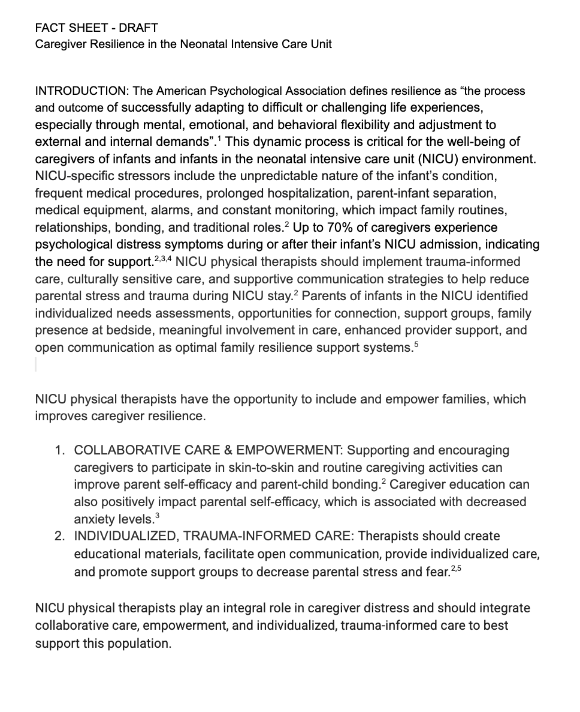
What?
Notes:
Which part of the PT role most directly impacts caregiver stress?

Slide 4
Impact?
Providers
Improves knowledge of caregiver resilience & family-centered care
Supports evidence-based practice and multidisciplinary care
Provides practical, easy to reference resources for care and education
Families
Improves caregiver education, involvement, and confidence
Supports caregiver coping and resilience
Enhances infant-parent bonding

