Slide 1


A Scoping Review of Preventive and Treatment Interventions of Parental Psychological Distress in the NICU in the United States
Barnett, K.A.I.; Sanders, A.; Kyser, R.; Babagoli, B.; Goyal, D.; Le, H.-N. A Scoping Review of Preventive and Treatment Interventions of Parental Psychological Distress in the NICU in the United States. Int. J. Environ. Res. Public Health 2025, 22, 1592. https://doi.org/ 10.3390/ijerph22101592

Slide 2
Intro
Get to Know You
  Which residency are you affiliated with?
  What is your NICU knowledge/exposure?
  Have you had any experience with caregiver distress (in or out of the NICU environment)?

Slide 3
PT Role in the NICU
APTA Neonatal Fact Sheet
  Screen neonates to determine needs for physical therapy referral.
  Examine neonates and interpret findings.
  Develop and implement a plan to prevent neurobehavioral disorganization and complications of prematurity in multiple systems.
  Design, implement, and evaluate the efficacy of intervention plans in collaboration with the family and medical team.
  Develop and implement discharge plans in collaboration with the family, medical team, and community resources.
  Consult with providers of specialized equipment or services in preparation for community-based care.
  Consult and collaborate with health care professionals, families, policy makers, and community organizations to advocate for services to support the development of neonates.
  Incorporate evidence-based literature into neonatal practice.
  Communicate, demonstrate, and evaluate neonatal physical therapy care procedures with NICU professionals and other caregivers.
  Develop a physical therapy risk management plan.
  Evaluate the effectiveness of a neonatal physical therapy program.
Notes:
Which part of the PT role most directly impacts caregiver stress?

Slide 4
NICU PT Fellowships
Programs
  Children’s Hospital of Philadelphia
  Nationwide Children’s
  Rocky Mountain University
  UNC
  Duke
Goals
  Develop advanced clinical reasoning in neonatal care
  Improve evaluation and treatment of high-risk infants
  Integrate family-centered and trauma-informed care
  Collaborate effectively within an interdisciplinary NICU team

Slide 5
Overview
Scoping Review
  What is the difference between a scoping review and a systematic review?
  Why might authors choose a scoping review over a systematic review?”
Participants
  Parents of preterm infants in the US who received interventions for psychological distress before, during, or after NICU discharge
Outcomes of Interest
  Depression
  Anxiety
  Stress
  PTSD
Which of these outcomes do you think impacts infant development the most?

Slide 6
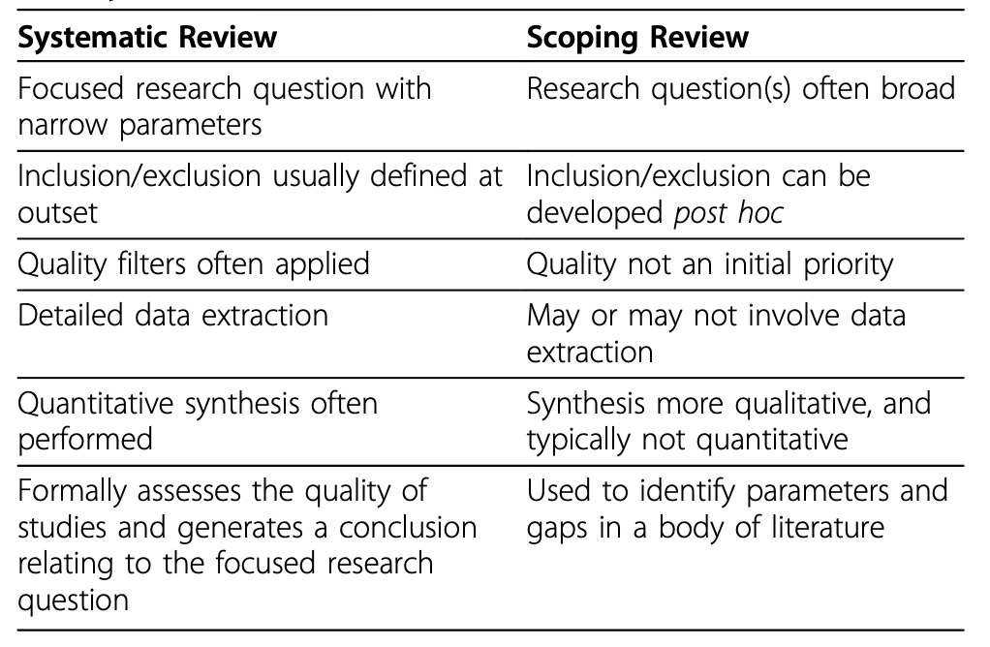
Systematic vs. Scoping

Slide 7
Methods
Search Strategy
  Databases: PubMed, Scopus, MEDLINE (via PubMed), and PsycINFO
  Timeframe: 2000 - April 1, 2025
Inclusion Criteria
  Preterm/very preterm infants or low/very low birthweight
  Randomized control trials (RCT), wait-list control, treatment as usual, standard care, attention control, or other interventions as comparison groups
  Interventions targeting parental depression, anxiety, PTSD, or stress
Exclusion Criteria
  Abstracts only
  Qualitative approach
  Infants diagnosed with congenital heart defects and congenital abnormalities
  Outside the US

Slide 8
Methods
Search Terms
  Pubmed: ("Intensive Care Units, Neonatal"[Mesh] OR NICU[tiab] OR "Intensive Care Units, Neonatal/organization and administration"[MAJR] OR "Infant, Premature"[MeSH] OR "Infant, Low Birth Weight"[Mesh] OR low birth weight[tiab] OR vlbr[tiab] OR lbw[tiab] OR elbw[tiab] OR very low birth weight[tiab] OR extremely low birth weight[tiab]) AND (nicu mother[MeSH] OR "Mothers/psychology"[MeSH] OR "Fathers/psychology"[MeSH] OR "Fathers"[MeSH] OR "Parents"[MeSH]) AND ("Anxiety"[Mesh] OR "Depression"[Mesh] OR "Cognitive Behavioral Therapy"[MeSH] OR "Anxiety/prevention and control"[MAJR] OR "Stress, Psychological/prevention and control"[MeSH] OR "Depression, Postpartum"[Mesh]) NOT "Heart Defects, Congenital"[MeSH] NOT "Congenital Abnormalities"[MeSH]
Critical Reasoning
  If you were designing this review, what would you change about the inclusion/exclusion criteria?
  What keywords do you think the authors used—and what might they have missed?

Slide 9
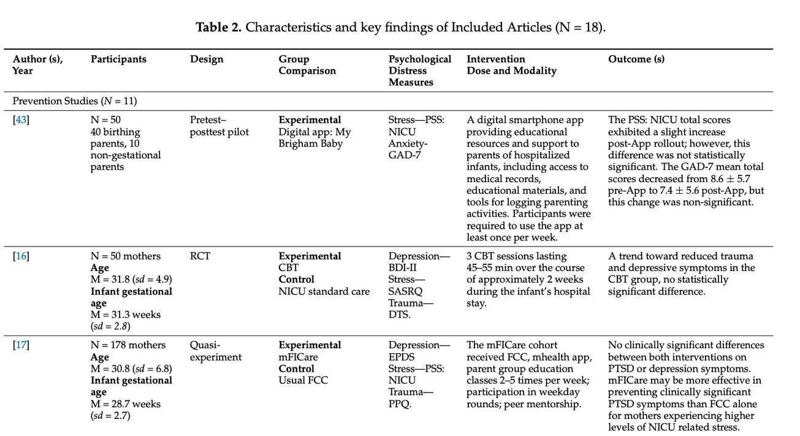
Characteristics
What key component of data extraction is missing from these articles?

Slide 10
Results
Big Picture
  Eight studies report statistically significant reductions of stress, anxiety, depression, and/or trauma symptoms
Significant Findings
  Creating Opportunities for Parent Empowerment (COPE) → less stress, depression, and anxiety
  Trauma Focused CBT → improvements in trauma, depression, and anxiety symptoms
  Art-based scrapbooking → decreased anxiety
  Listening sessions → reduced depressive and anxiety symptoms
  Mindfulness-based Neurodevelopmental Care → decreased stress
Is this enough evidence to change practice?

Slide 11
Application
Limitations
  No adjustment for sociocultural differences
  Only represents heterogeneous couples
  Limited representation of non-birthing parent
Engagement
  High engagement with: short, flexible interventions that can be completed bedside
Barriers
  High parental stress
  Work obligations
  Travel distance
  Need to be present at the infant’s bedside
  Managing other responsibilities
Which barrier is hardest to overcome in real life?

