Slide 1
Fun with Food: Feeding Education Strategies for Families and Practitioners
Who?
What?
Why?
Alyssa Tsui (she/her)
Education + Awareness
Resources for clinicians + Families
3rd year Occupational Therapy Student
Va-LEND Long-Term Academic Trainee
Project chosen based on past experiences and interests
Direct benefit to community
1. Brochure
2. Clinician and Volunteer Guide
3. Family Resource Folder
Notes:
My name is Alyssa Tsui (she/her), and I am an occupational therapy student. The title of my final project is called Fun with Food: Feeding Education Strategies for Families and Practitioners. I collaborated with a local clinic to (1) create a brochure for families with resources and strategies on play- and sensory-based feeding, oral motor exercises, food consistency milestones by age, environmental and material considerations during feeding, infant feeding, and how to schedule a feeding evaluation; (2) a supplemental clinician and volunteer guide on the mentioned topics; and (3) an online family resource folder. I chose this project based on my past experiences and interests in feeding therapy as well as my desire to provide a resource that would directly benefit the community on this lesser-known topic. I hope these materials will increase awareness of strategies to address feeding challenges in the home and to trigger a feeding evaluation when needed so that children and their families can get connected to resources earlier.

Slide 2


Slide 3
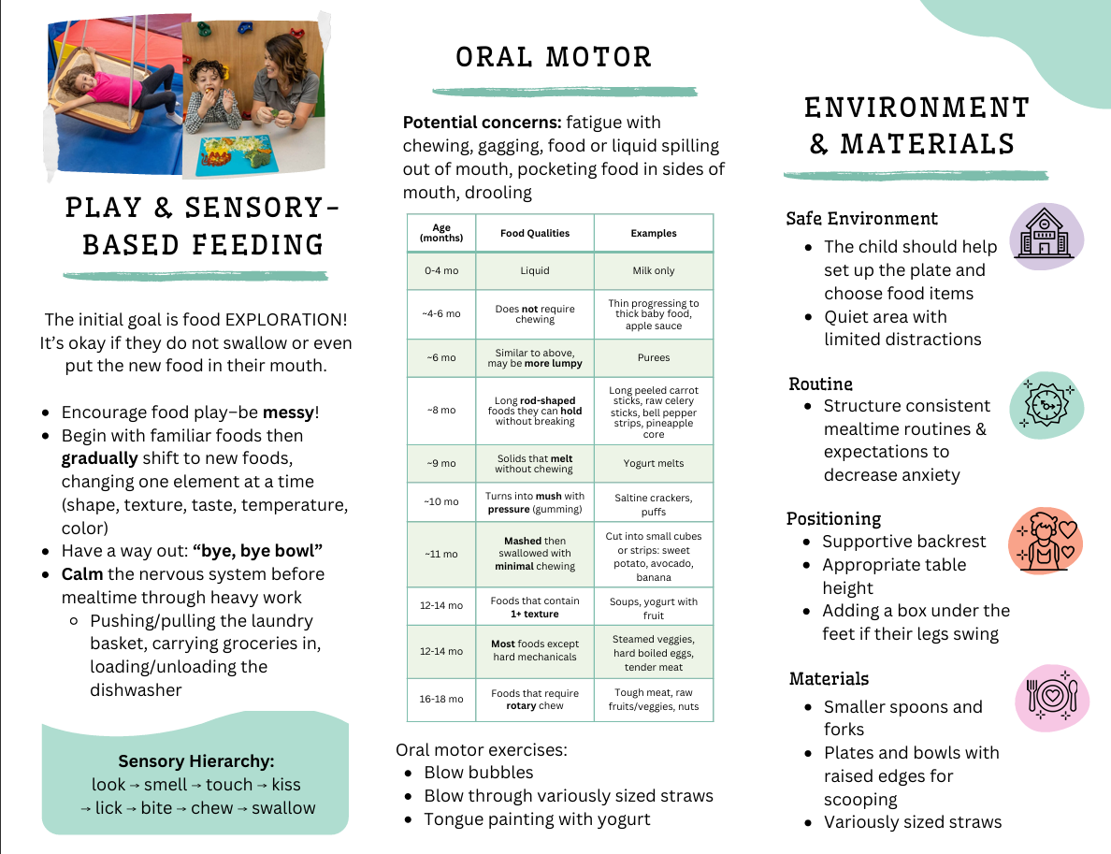

Slide 4
