Slide 1
Strong Families, Strong Supports: Uplifting Military Children with Disabilities by Christina M. Escalante, M.A.Ed

Slide 2

What Helped You Belong?
Take a moment to reflect on your school experience…..
What helped you feel steady or supported?
What made you feel like you belonged?
Turn to a partner and share:
A person, routine, or moment that stayed with you
Notes:
Before we begin with today’s presentation, we are going to start with a quick activity.
Let’s take a moment to think back to our own childhoods, especially your time in school.
What helped you feel a sense of routine or stability?
What made you feel like you belonged?
Maybe it was a teacher, a predictable routine, a friend, or even something small that helped you feel safe or understood.
Now let’s take a few minutes to share in pairs or small groups.
What stands out to you from that time?
What made the biggest difference in how you experienced school?
(Give about 5 minutes)
Now, let’s come back together.
What are some common themes you noticed?
(Allow for responses)
Thank you for sharing those. Common themes that continually come up are things like consistency, connection, understanding, and feeling valued. All of these are incredibly important. They are the same things that support military children as well.
Now, imagine having to rebuild those same supports every 2–3 years. New school, new teachers, new routines, new friendships. What would that feel like?
As we move into today’s session, I would love for us to keep those experiences in our minds because those same factors are especially important for military children with disabilities, who may be navigating frequent transitions and additional challenges.
Today is really about how we can intentionally create those moments of belonging and stability in our roles.

Slide 3
Meet the Student - Alex
2nd grader
Military-connected family (active-duty parent)
Has moved schools multiple times
Has an IEP for speech and learning support
Friendly, curious, loves science, and hands-on activities
Trying to make new friends
Think and Reflect
What might feel confusing or stressful for Alex?
What strengths might Alex bring to the classroom?
What support would make him feel safe and included?
Notes:
Today, we are talking about military-connected children, including those with disabilities. You don’t need to be a military expert or a special educator – this is about understanding the child in front of you and knowing that small actions matter. When we say military-connected child, we’re talking about students who have a parent or caregiver in the military – active duty, National Guard, and Reserve. Some move often, some don’t. Some experience deployments, some are preparing for one. There’s no single military child experience, but change is a common thread.
(Activity 5 minutes)
So let’s slow down for a moment and try to imagine life from the perspective of a military-connected student with a disability. This helps us understand what stability, support, and empathy look like from their point of view. Meet Alex. Alex is a second grader who recently joined your class. Alex is from a military-connected family and has moved schools several times already. Alex has an IEP, but like many military-connected students, services and records may take time to transfer. Alex is curious, friendly, and really enjoys science especially hands-on learning. Like many students, Alex brings both strengths and needs into the classroom.
Now let’s take a quiet moment to think about Alex or a student you’ve taught who reminds you of him. You may jot your thoughts down. Think about his first day of school. What might feel confusing right now? What strengths does he bring into your classroom? What challenges stood out to you? And what helps a child feel safe and welcome on their first days? (pause for 1-2 minutes for reflection)
If you are comfortable, turn to someone near you and share one thing you already do that would help a student like this or one question you might have. (pause for about 1-2 minutes) Would anyone like to share their thoughts with the group? (take one or two responses)
For military connected children with disabilities, changes can add up quickly, such as new schools, new routines, new adults, and often times gaps in services. These changes can affect academic progress, social-emotional health and confidence. Military connected children with disabilities are resilient but they shouldn’t have to navigate change alone. Even without special education training, general educators are often the first safe, steady presence these children experience. Even small actions like checking in, being aware of transitions, and connecting families to resources can help students feel seen, supported, and ready to succeed.

Slide 4
Objectives
Learn about military-connected children, including those with disabilities
Understand military family life and how it affects children
Discovery helpful resources to support families and schools
Learn practical ways to help students feel safe and supported
Notes:
By the end of the session, you’ll know who these students are, understand how military life can affect them, discover helpful resources, and explore practical ways to support them.

Slide 5
Who are Military-Connected Students?
Under Virginia Code § 22.1-287.04, a uniformed services-connected student (military connected children) is defined “as a student enrolled in a public school whose parent is serving in either:
the active component of the U.S. Army, Navy, Air Force, Marine Corps, Coast Guard, Space Force, National Guard, the Commissioned Corps of the National Oceanic and Atmospheric Administration, or the Commissioned Corps of the U.S. Public Health Service; or
the reserve component of the U.S. Army, Navy, Air Force, Marine Corps, Coast Guard, Space Force, or National Guard.”
Notes:
Read slide:
Under Virginia Code § 22.1-287.04, a uniformed services-connected student is defined as a student enrolled in a public school whose parent is serving in either:
the active component of the U.S. Army, Navy, Air Force, Marine Corps, Coast Guard, Space Force, National Guard, the Commissioned Corps of the National Oceanic and Atmospheric Administration, or the Commissioned Corps of the U.S. Public Health Service; or
the reserve component of the U.S. Army, Navy, Air Force, Marine Corps, Coast Guard, Space Force, or National Guard.

Slide 6
Military Connected Students: By the Numbers
Nearly 1.5 million military connected student in the U.S.
Virginia public schools educate 77,000 military-connected students
Virginia ranks #1 in the nation for the number of military installations or bases
About 10-15% of military-connected students receive special education services
About 23-28% of military connected children have special health care needs, which includes chronic illness, developmental disabilities, and/or behavioral health conditions.
(Goodale, 2022), (Jowers, 2019), (Perkins et al., 2026)
Notes:
Across the country, nearly 1.5 million military-connected students are part of our communities. In Virginia, alone, there are over 77,000 of these students. About 10 – 15% receive IEP services, which are school based services for learning-related disabilities. But when we look at special health care needs, the number is much higher, about 23 to 28%. This includes medical, developmental, and behavioral conditions. These groups don’t fully overlap. Many children have needs that don’t qualify for an IEP, so relying only on school data underestimates how many military connected children have disabilities. This helps to explain why schools are such important sources of stability and support for these students.

Slide 7
Getting to Know Military-Connected Students
Family Strengths
  Resilience and adaptability
  Strong community bonds
  Cultural competence
  High level of discipline
Family Needs
  Consistent childcare
  Timely educational support for children
  Employment opportunities for spouses
  Establish a reliable support system
Notes:
Military families possess remarkable strengths, such as resilience, adaptability, tight community bonds, cultural competence, and strong discipline.
At the same time, they may face challenges such as finding trustworthy childcare, quickly securing educational support for their children, establishing a reliable support system, and securing job opportunities for spouses. Sometimes a family doesn’t even have a name to list as their child’s emergency contact. These hurdles can seem overwhelming, but they can also be transformed into strengths. Frequent moves, for example, can build adaptability and social confidence in children, while navigating uncertainty can strengthen problem-solving skills and family unity.
Educators play a key role in helping turn these challenges into strengths by being sensitive and responsive to each family’s needs. This means listening without judgment, learning about each family’s situation, and valuing the skills they already bring. Teachers can offer flexible communication, help families connect with school and community resources, and create consistent, supportive classroom environments. By building trust and highlighting what families do well, educators empower military families to see their experiences not as barriers, but as valuable assets that support their child’s success.

Slide 8
Military Supports Can Look Different
Notes:
Support for military families can be quite diverse. Parents might have different roles or titles, and each branch (Army, Navy, Air Force, Marine, Space Force, National Guard, and Coast Guard) provides it own unique resources. Even installations (or bases) within the same branch might offer different programs, and the names of these programs can vary as well. Understanding these differences can help families find the support they need quicker.
As educators, it’s important to ask thoughtful questions, work closely with families, and stay flexible to ensure every student receives the support they need.

Slide 9

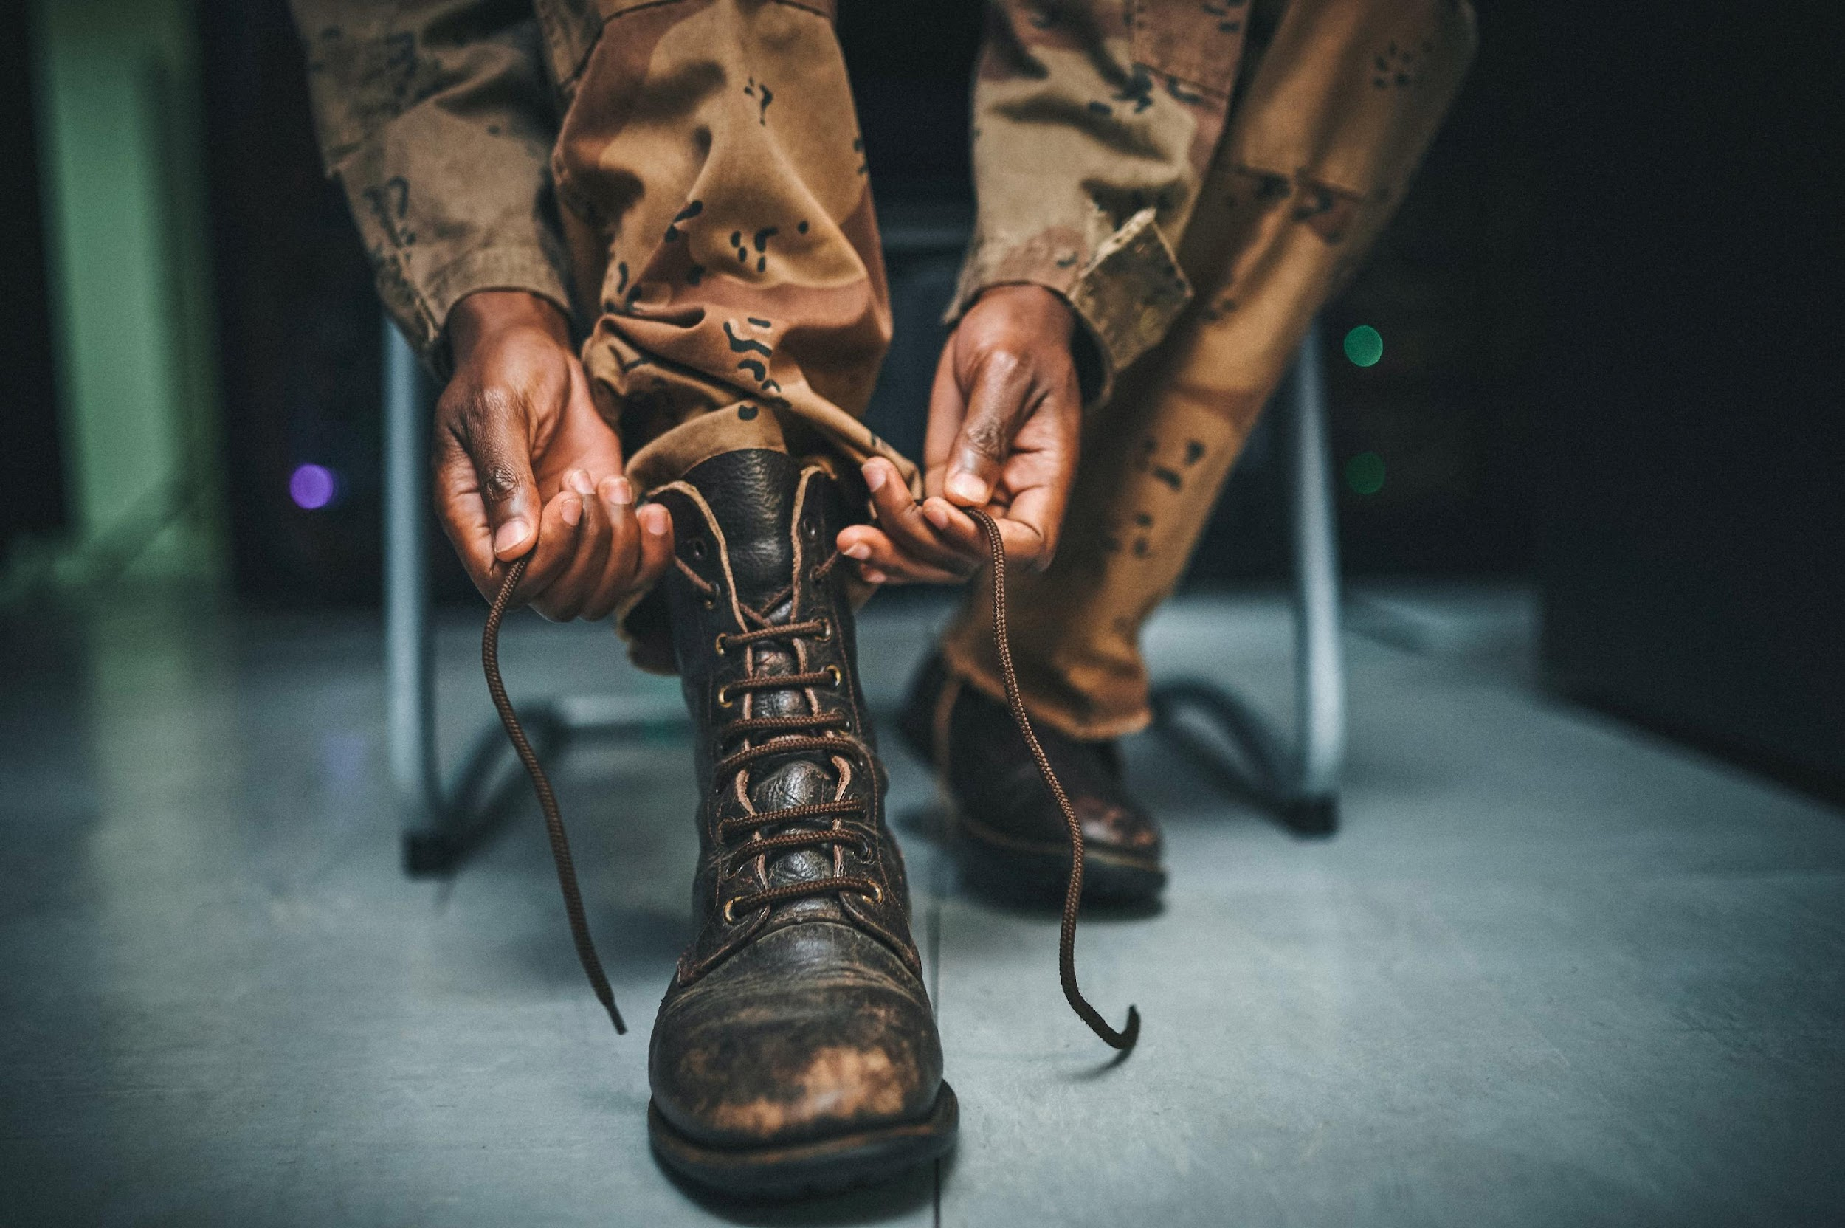
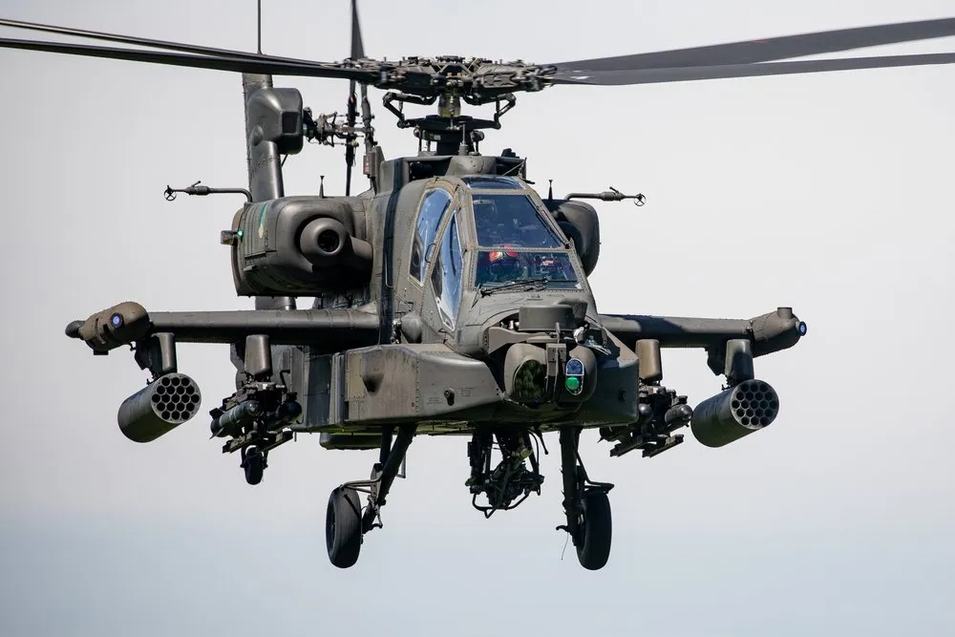
Transitions
Notes:
Military life revolves around frequent transitions. Families might relocate (or PCS – Permanent Change of Station) every 2-3 years. One or both parents could be deployed or away on training rotations and the child may stay with the other parent or even at another location with family or friends. PCS moves can occur on short notice and can happen anywhere, either within the Continental US (CONUS) or outside of it (OCONUS). Additional transitions can include a parent retiring after at least 20 years of service, a parent leaving at the end of their military contract, a medical discharge, or just returning to civilian life.
Understanding these transitions enables educators to offer stability, predictability, and support within the school environment.

Slide 10
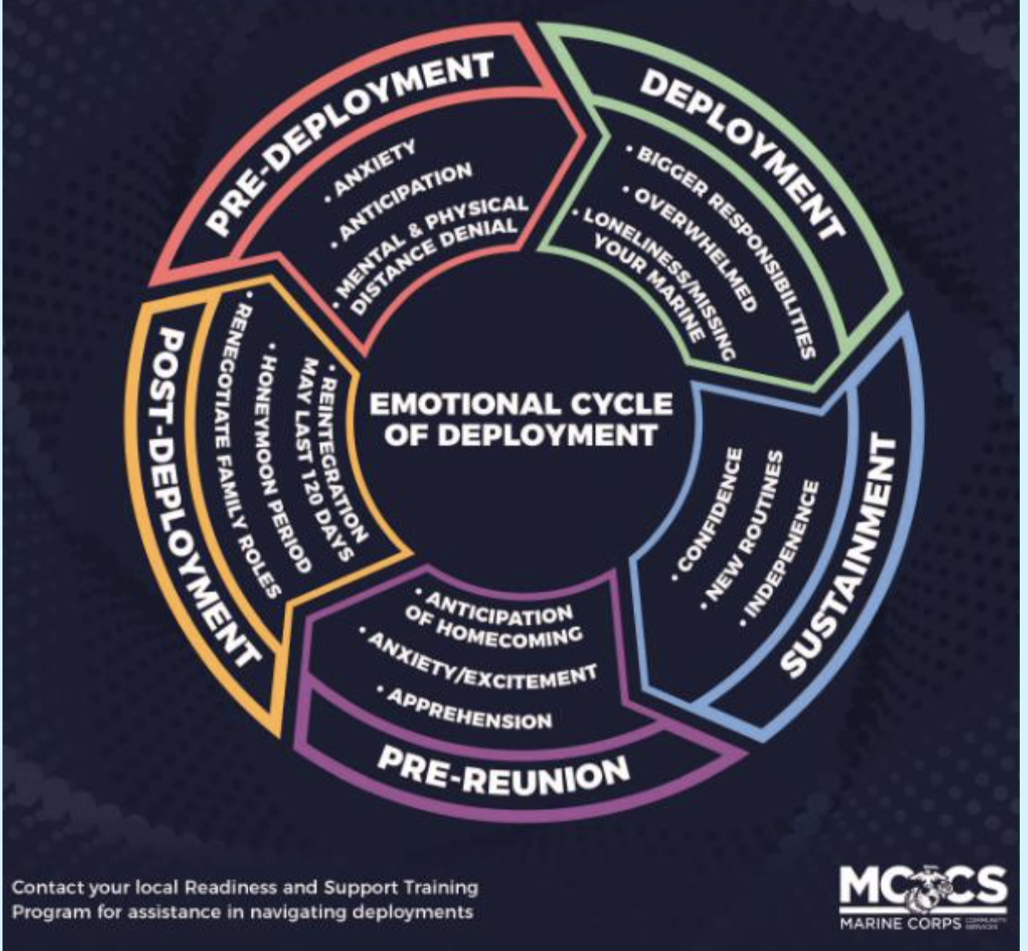
Each phase brings changes in routines, emotions, and behavior.
Children move through these phases differently and at their own pace.
What about our new student, Alex?
Notes:
On the previous slide, I mentioned transitions and highlighted deployments and training rotations as two examples. Sometimes a deployment may be in a war zone or during wartime, or it may not. Either way, it still creates significant change for families. Training rotations can also mean extended periods of time when children are away from their active-duty parent or parents. During these times, children may move through similar emotional cycles as they would during a deployment.
You might see changes in routines, emotions, or behaviors as things shift around them.
Let’s step back for a moment to Alex, who we met earlier.
Alex has just found out his active-duty mom will be deployed for 8 months on a ship, and his grandparents will be coming to his home to take care of him.
Using the emotional phases of the deployment cycle can help us better understand what Alex may be experiencing during this transition.
At first, he may feel shock, confusion, or worry as he processes the news. As the deployment gets closer, those feelings might turn into anxiety, sadness, or even changes in behavior. During the deployment, Alex may begin to adjust, but still have moments where he feels stressed or misses his mom.
When we understand these phases, we can respond with empathy and intention.
So what can we do?
(Give the group time to provide a few responses).
Thank you for sharing those ideas. (add any of the following that was not shared)
We can provide consistent routines, check in with Alex regularly, and create a safe space where he feels comfortable expressing his feelings. We can also support his grandparents by keeping open communication and working together to provide stability.
By using the deployment cycle as a guide, we can better anticipate Alex’s needs and help create a sense of connection, support, and belonging during this time of change.
(Do not have to explain but is good information to have to share if asked:
What this can look like for children:
Pre-deployment: anxiety, clinginess, difficulty focusing
Deployment: sadness, withdrawal, regression
Sustainment: adjustment, mixed emotions, fluctuating coping skills
Pre-Reunion: restlessness, excitement, emotional ups/downs
Post-Deployment: readjustment, behavior shifts, testing limits)

Slide 11
What does this mean for children with disabilities?
Transitions are more intense and disruptive.
Stress may show up through behavior or communication.
Routines and predictability become even more important.
Adjustment may take more time and support.
Notes:
For children with disabilities, these changes can feel even bigger.
Stress might show up in behavior or communication, and transitions can take more time.
So what we’re seeing in the moment may actually reflect where they are in the cycle.
And that’s where our support can really make the difference.

Slide 12
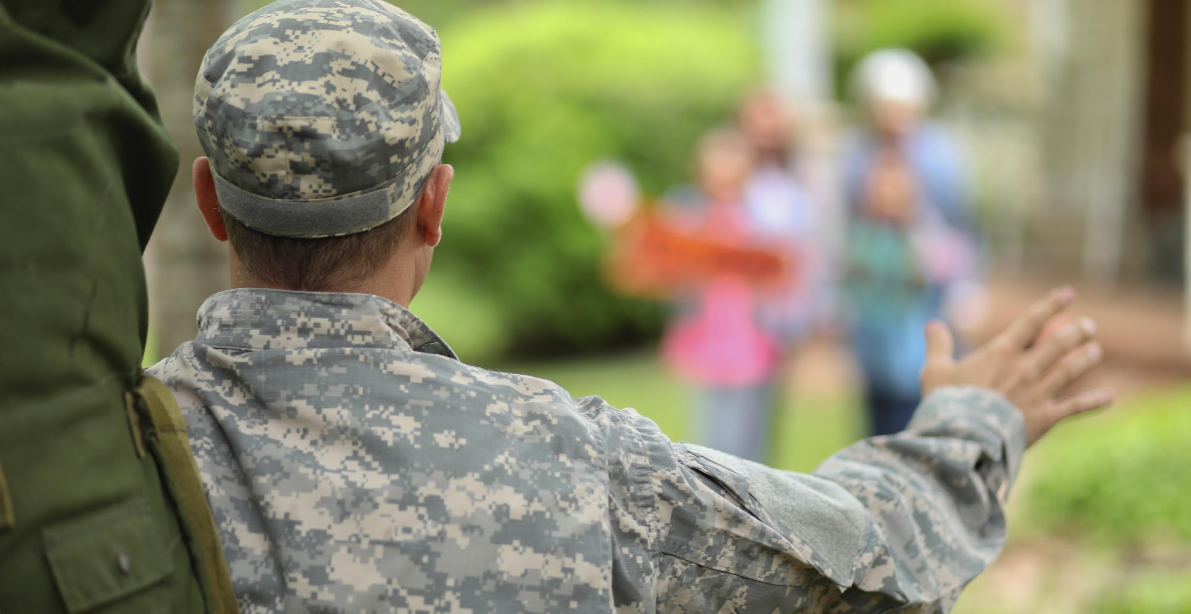

School and Student Impacts
Frequent moves – academic gaps, social disruption, inconsistent Special Education/Gift Services
State to state differences – policies, regulations/laws, curriculum alignment, credit transfers
Parental deployments – stress, anxiety, grief; may affect behavior and concentration
Family roles may shift – students take on more responsibilities at home
Medical/Therapies – breaks in OT/PT/speech/ABA; difficulty finding new providers; complex medical system
Notes:
This slide summarizes what we have covered so far. Military-connected students often encounter challenges in academics, social life, and family matters, yet schools play a vital role in supporting them. By understanding policies, transitions, and family stressors, educators can offer more effective support. When schools provide strong support, it positively impacts students’ academics, friendships, and overall happiness.
So what are some concrete ways we can support families?
(Give the group time to provide a response. Share any of the following strategies that were not offered.)
We can establish consistent routines and clear expectations to provide stability. We can communicate regularly with families using flexible methods that meet their needs. We can create welcoming environments where students feel seen, valued, and connected. We can also collaborate with families and caregivers, including extended family members, and connect them with school or community resources when needed.
Even small actions like checking in with a student, learning about their background, or offering extra support during transition can make a meaningful difference.

Slide 13
“Moving with children with disabilities was a challenging learning process. It was scary not knowing how schools worked or how our children would be supported. We felt a lot of anxiety about the well-being of our kids. My involvement as a parent was key to building relationships with each school team to make the transition as smooth as possible.”
**Amanda, retired military spouse and parent of two children with disabilities
Notes:
Read slide.
This quote reflects the lived experience of military families with children with disabilities. Frequent moves can interrupt services, relationships, and trust. When schools prioritize collaboration, continuity, and empathy, they help reduce the impact of the transition and ensure students don’t lose progress simply because of relocation.

Slide 14
Revisiting our Case Study with Alex
2nd grader
Military-connected family (active-duty parent)
Has moved school multiple times
Has an IEP for speech and learning support
Friendly, curious, loves science, and hands-on activities
Trying to make new friends
Has been in your class for 3 months
Mom is going on deployment and grandparent are moving in to take care of him
Notes:
Let’s take a moment to review what we know so far about Alex; however, we now have some additional information to work with.
He has been in his current classroom for about three months, and he has just found out that his mother, an active-duty sailor, will be deployed for the next 8 months on a ship. He has also just found out that his grandparents will be temporarily moving into their home to help care for him.
Those are a lot of changes for Alex to have to process.
Reflect on that information for a moment.

Slide 15
Case Study: Alex
What might this student or family be experiencing right now?
What might you do immediately as a classroom educator?
Who in the school could you partner with?
What resources or strategies might help?
Notes:
(Answer these questions with the group.)
What might this student or family be experiencing right now?
The student may be feeling anxious and unsettled due to the upcoming deployment, the recent move, and adjusting to new caregivers, while also navigating challenges related to his speech and learning needs.
What might you do immediately as a classroom educator?
Provide a consistent routine, engage him with hands-on science activities, and check in regularly to offer emotional support and help him build friendships.
Who in the school could you partner with?
Collaborate with the special education teacher, school counselor, and any military family support staff to coordinate academic and emotional support.
What resources or strategies might help?
Use visual schedules for routine, social-emotional learning activities to support coping, peer buddy systems for social connection, and maintain open communication with his grandparents and family.

Slide 16



Small Group Activity
Scenario 1:
A 3rd grade student arrives mid-year from another state. The family hasn’t received the full IEP yet, and the student is struggling academically and socially.
Scenario 2:
A kindergarten student whose parent recently deployed is having emotional outbursts and difficulty separating from caregivers at school.
Scenario 3:
A student previously receiving speech and OT services has experienced a gap due too a recent PCS move and long waitlists in the new community.
Notes:
We were able to brainstorm some ways that we could help Alex and his family. Now let’s see how we might be able to help these other students.
Activity 8-10 minutes
Now let’s shift into problem solving mode. You don’t need to be a special education expert to make a difference. Let’s break into groups of about 3-5 individuals. Each group is going to take one scenario. In your groups, talk through the scenario and focus on what you could do right away, who you might partner with, and how your school could help support this student and family. You will have about five minutes for this task and then we will come together to discuss our thoughts.
(Once each group has information about their scenario, display the next slide.)

Slide 17
Team Problem Solving
What might this student or family be experiencing right now?
What might you do immediately as a classroom educator?
Who in the school could you partner with?
What resources or strategies might help?
Notes:
Give each group 5 minutes to discuss.
What stood out to you? What felt doable? Often, it’s the small, thoughtful steps, like checking in, asking questions, including support staff, that create stability for students.
Talking points/Discussion:
Collaboration matters more than having all the answers.
Early communication and flexibility reduce stress for families.
Awareness leads to better decisions and stronger trust.

Slide 18



Helpful Resources for Families
MIC 3 (Military Interstate Children’s Compact Commission) – Ensures smooth school transition across states.
Purple Star Schools celebrate and support schools that assist military-connected students, showing their commitment to creating inclusive and caring environments.
Virginia’s Parent Training Center – PEATC’s Military Outreach – Offers supportive one-on-one consultations, training and resources to help parents navigate special education and disability services in Virginia.
Notes:
As we’ve discussed military families move a lot – and for children with disabilities, those moves can mean lost services and added stress. These three resources help make transitions smoother.
Read slide. Can also give examples.

Slide 19
More Helpful Resources for Families
The Exceptional Family Member (EFMP) and Special Needs Programs are military-based initiatives that connect families with members with disabilities to a wide range of helpful services and resources.
School Liaison Program is a military-based initiative that supports families in navigating enrollment, accessing school services, and building community connections.
Child and Youth Programs/Services are military-based initiatives aimed at fostering children’s growth and social skills.
Military Community Services/Family Support are military-based initiatives that provide counseling, financial assistance, and other family resources.
Notes:
These wonderful resources are here to support our military families in many ways. MIC 3 helps make transitions between states easier, while Purple Star Schools celebrate those who go above and beyond to help military-connected students settle in. PEATC is here to help families understand special education and disability services in Virginia, and EFMP offers assistance with resources available on bases and in communities to help family members with disabilities. School liaisons are great guides for navigating school enrollment and programs. Child and Youth Programs provide childcare and fun activities for children, and Military Community Services offer practical support for families. Sharing these resources highlights how schools can truly partner with families to foster student success and community strength.

Slide 20
Practical School Strategies & Culture of Support
Child Focused | Family Focused
Greet new students and provide them with a “buddy” to help them acclimate. | Designate a military family contact person for the school. Create a parent buddy/peer program to provide support.
Identify any developmental/academic gaps present due to moving or switching curriculums. | Hold IEP Meetings promptly when families initially arrive.
Educate staff about the military lifestyle. | Find ways to include the deployed parent through technology (Zoom, emails, texts).
Stay aware of key dates such as homecomings and deployments. | Be familiar with the MIC3 guidelines to facilitate a smooth transition for families.
Train staff on information about deployments and trauma. It helps everyone feel supported during challenging times. | Offer additional assistance when necessary.
Notes:
As you can see, schools can actively support military-connected students through welcoming, academic, social, and family engagement strategies. By offering thoughtful and caring support, educators can help student feel safe, connected, and confident in their schools.

Slide 21
Conclusion
Military life is like an adventure where everyone in the household has their special role to play.
Community support makes a big difference, providing families with the strength and resilience they need to thrive.
Understanding the cycles of military life helps schools create a supportive environment filled with stability, empathy, and encouragement.
Notes:
As we circle back to the end, it’s wonderful to remember that military service is really a shared family adventure. Schools and communities that step up with proactive support can truly make a big difference, helping students and families feel more connected and cared for. When we understand the ups and downs of military life, we can offer stability, empathy, and lots of encouragement to help military-connected students shine and succeed.

Slide 22
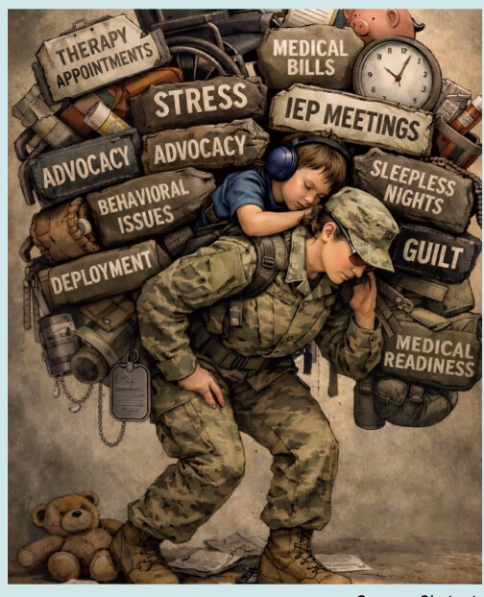
Questions or Curiosities
**ChatGPT Created Image of Col. Joetta Khan, Army
Dietician and Parent of a Son with Disabilities, 2026

Slide 23
References:
Goodale, J. (2022). Survey Reveals Major Delays in Special Education Services for Military Children. MOAA
https://www.moaa.org/content/publications-and-media/news-articles/2022-news-articles/advocacy/survey-reveals-major-delays-in-special-education-services-for-military-children/
Jowers, K., (2019). Study: Military Children Have More Health Care Needs But Less Access and Lower Quality. MOAA/Military Times
https://www.moaa.org/content/publications-and-media/news-articles/2019-news-articles/study-military-children-have-more-health-care-needs,-but-less-access-and-lower-quality
Perkins, E., Sorenson, I., Susi, A., & Hisle-Gorman, E. (2026). The Impact of Having a Child with Special Healthcare Needs on Length of Military Service. Military Medicine.
https://academic.oup.com/milmed/article/188/5-6/e1246/6444240

Slide 24
Resource: Who are service members?
Federal Government
Dept of Defense/War
Dept of Homeland Security
Army
Air Force
Space Force
Navy
Marine Corps
Coast Guard

Slide 25
Resource: Who are service members?
State
National Guard
Air National Guard
Army National Guard

Slide 26
Resource: Common Terms
Active Duty: full-time service member
National Guard: Serve both State (Governor) and Federal (President) missions; know as “Citizen Soldiers”
Reserves: each branch of service has a reserve component, mobilized during wartime or national emergencies; meet monthly for training
Veteran: anyone who has served in the military
Branch Specific Service Member Terms: Soldiers (Army), Sailors (Navy), Airmen (Air Force), Guardians (Space Force), Marines, Coast Guardsman

Slide 27
Resource: Common Terms for Transitions
Deployment: long term absences (combat/non-combat)
Training Rotations: short-to-mid-term absences
PCS: Permanent Change of Station; moving every 2-3 years
OCONUS: Outside Continental US
CONUS: Inside Continental US
Other Transitions: ETS (End of Service), retirement (after 20 years or more); returning to civilian life

