Slide 1

VA LEND Leadership Project
CHRISTINA M. ESCALANTE, M.A.ED.

Slide 2






Introduction and Background
Christina M. Escalante – VA LEND Trainee
Project: “Strong Families, Strong Supports: Uplifting Military Children with Disabilities”
Education and Psychology Lens
Most educators will have a military-connected student

Slide 3
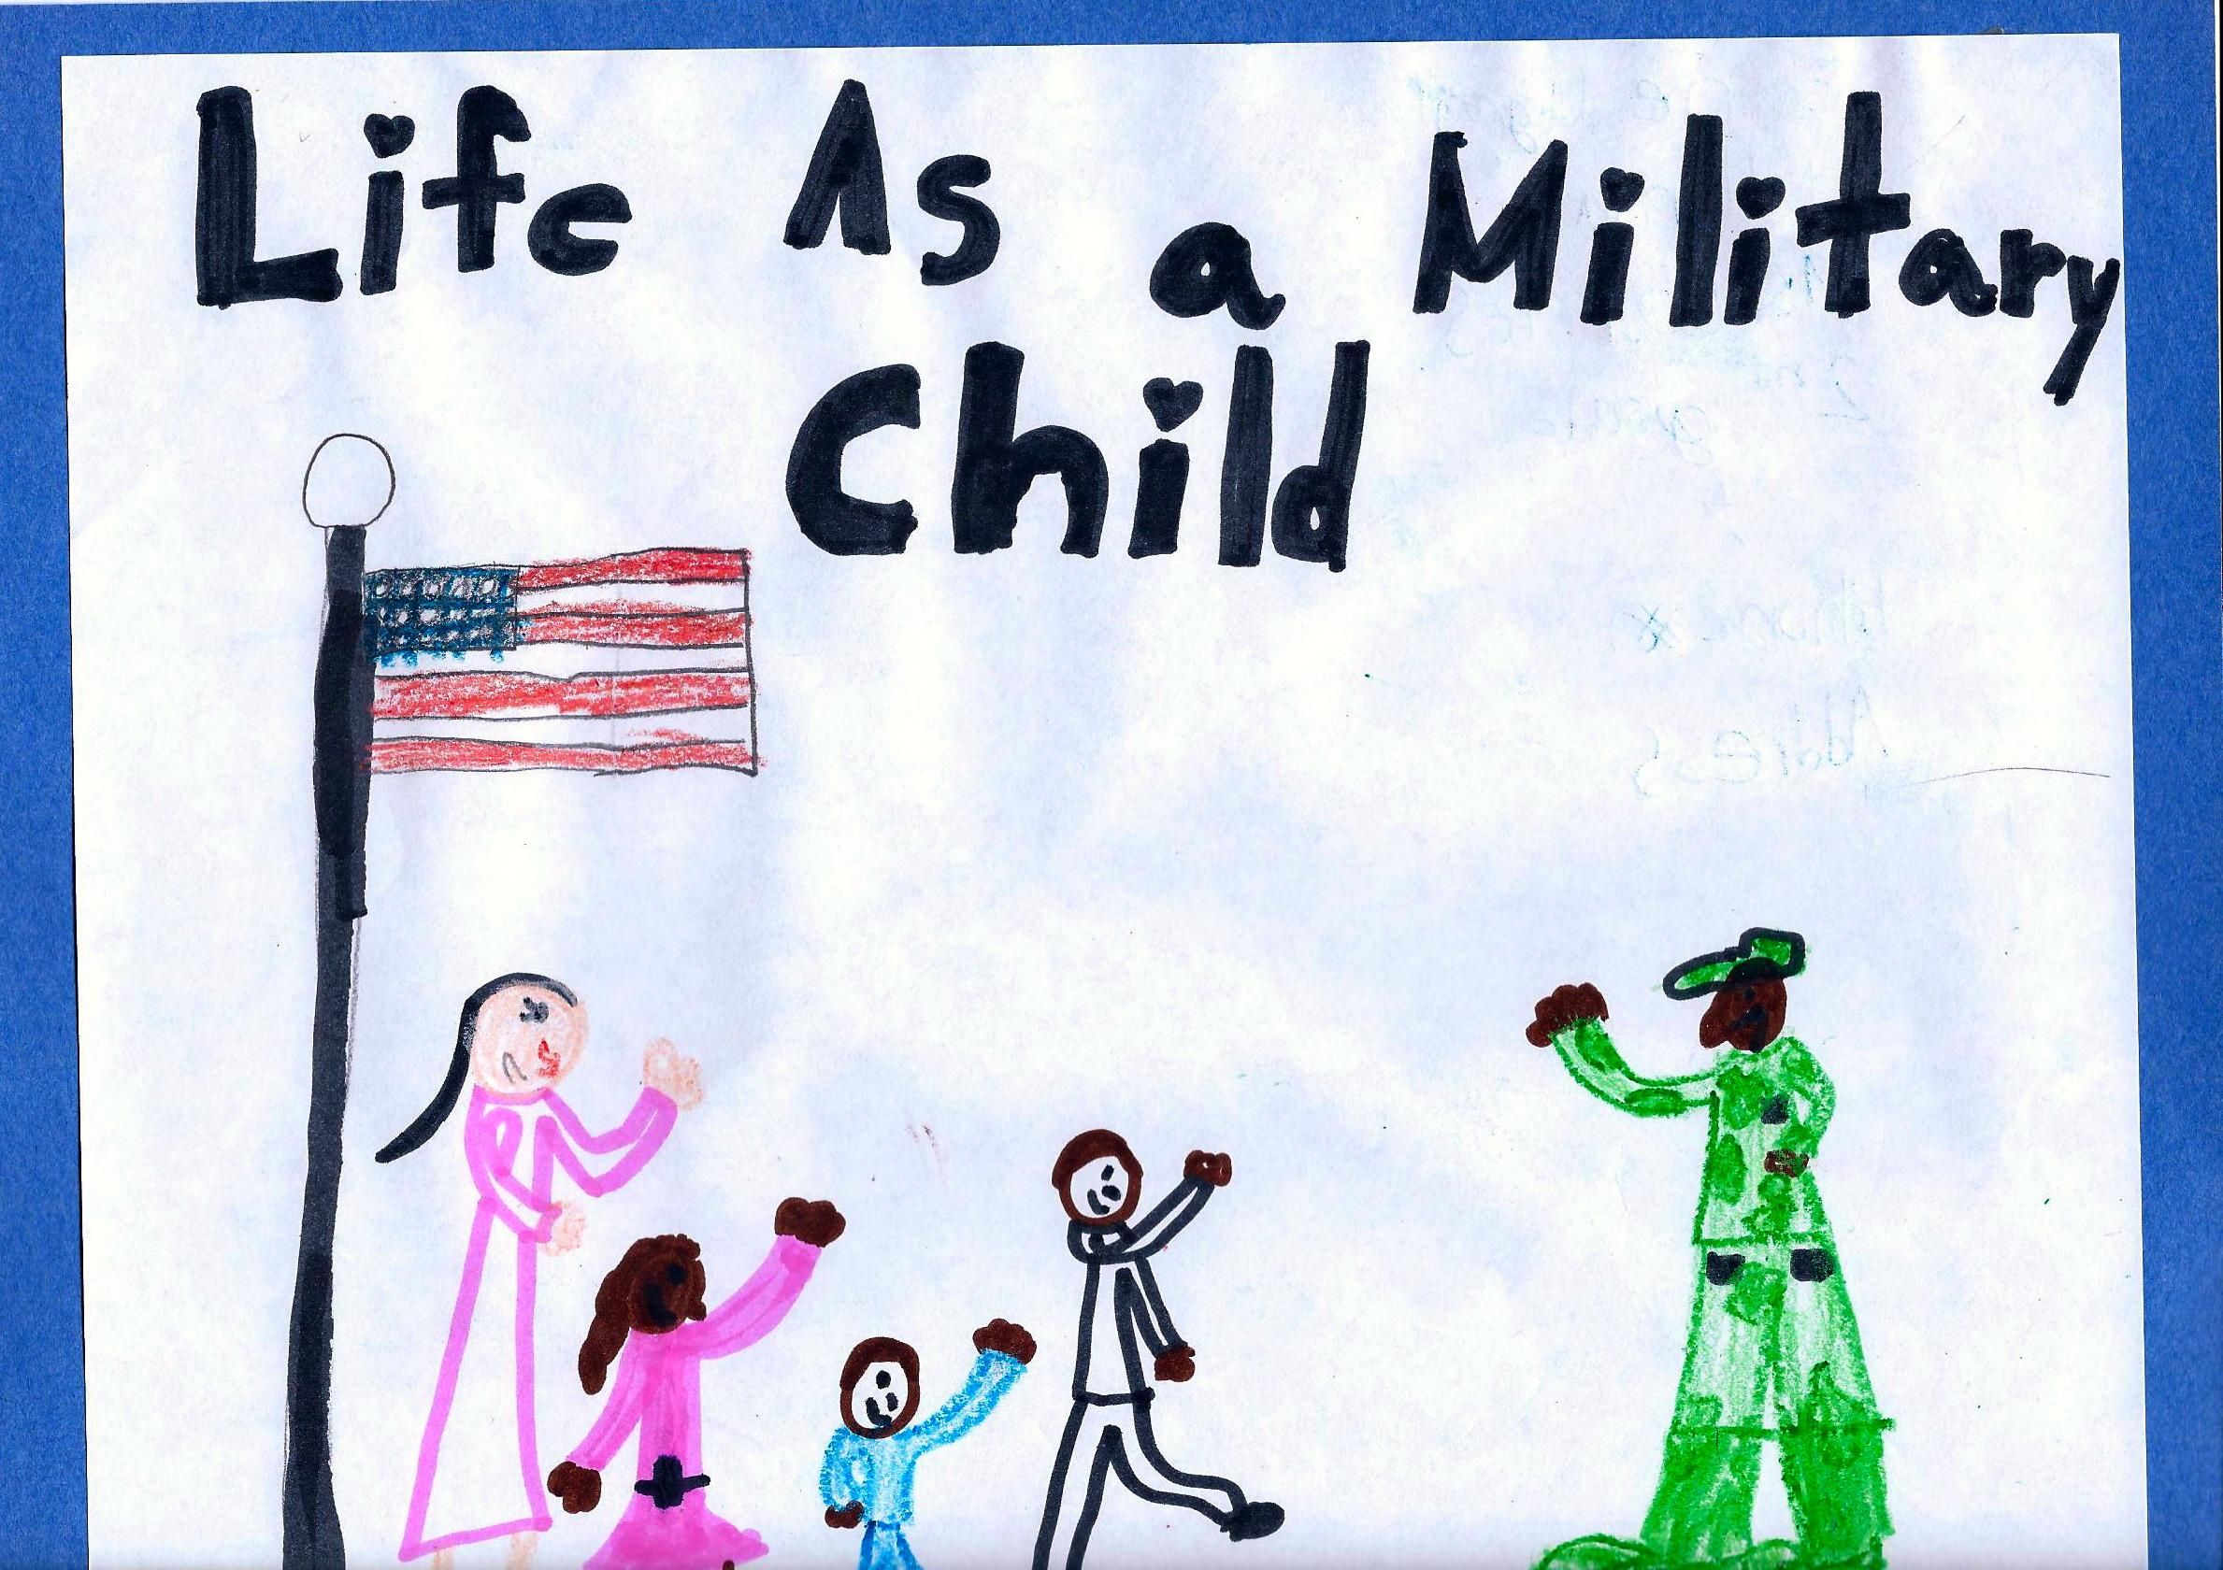
Why It Matters
77,000 military-connected children in Virginia’s public schools
About 10% receives special education services
About 20% have special health care needs
Moves, deployments, transitions impact learning and well-being
This Photo by Unknown Author is licensed under CC BY

Slide 4

Project Goals & Impact
Case studies show real stories
Concrete strategies for educators
Build inclusive, supportive classrooms
Help every child thrive academically and socially

