Slide 1

Protective Orders for Survivors with Disabilities
Amira Eldridge, PBSF, QMHP-T
LEND Long Term Academic Trainee
Self Advocate Discipline
April 2026

Slide 2
Protective Orders for Survivors with Disabilities
What I did for my project:
Why I chose this project:
Collaborated with the LOTUS project to develop a series of one pagers based on their larger protective order resource
Assisted the LOTUS project with developing a training curriculum based on their research study focused on consent for people with disabilities
To contribute to the LOTUS project’s mission of making the criminal justice system more accessible to people with disabilities
I was inspired by my experience working with people with disabilities within a domestic and sexual violence organization compared to disability-specific settings

Slide 3

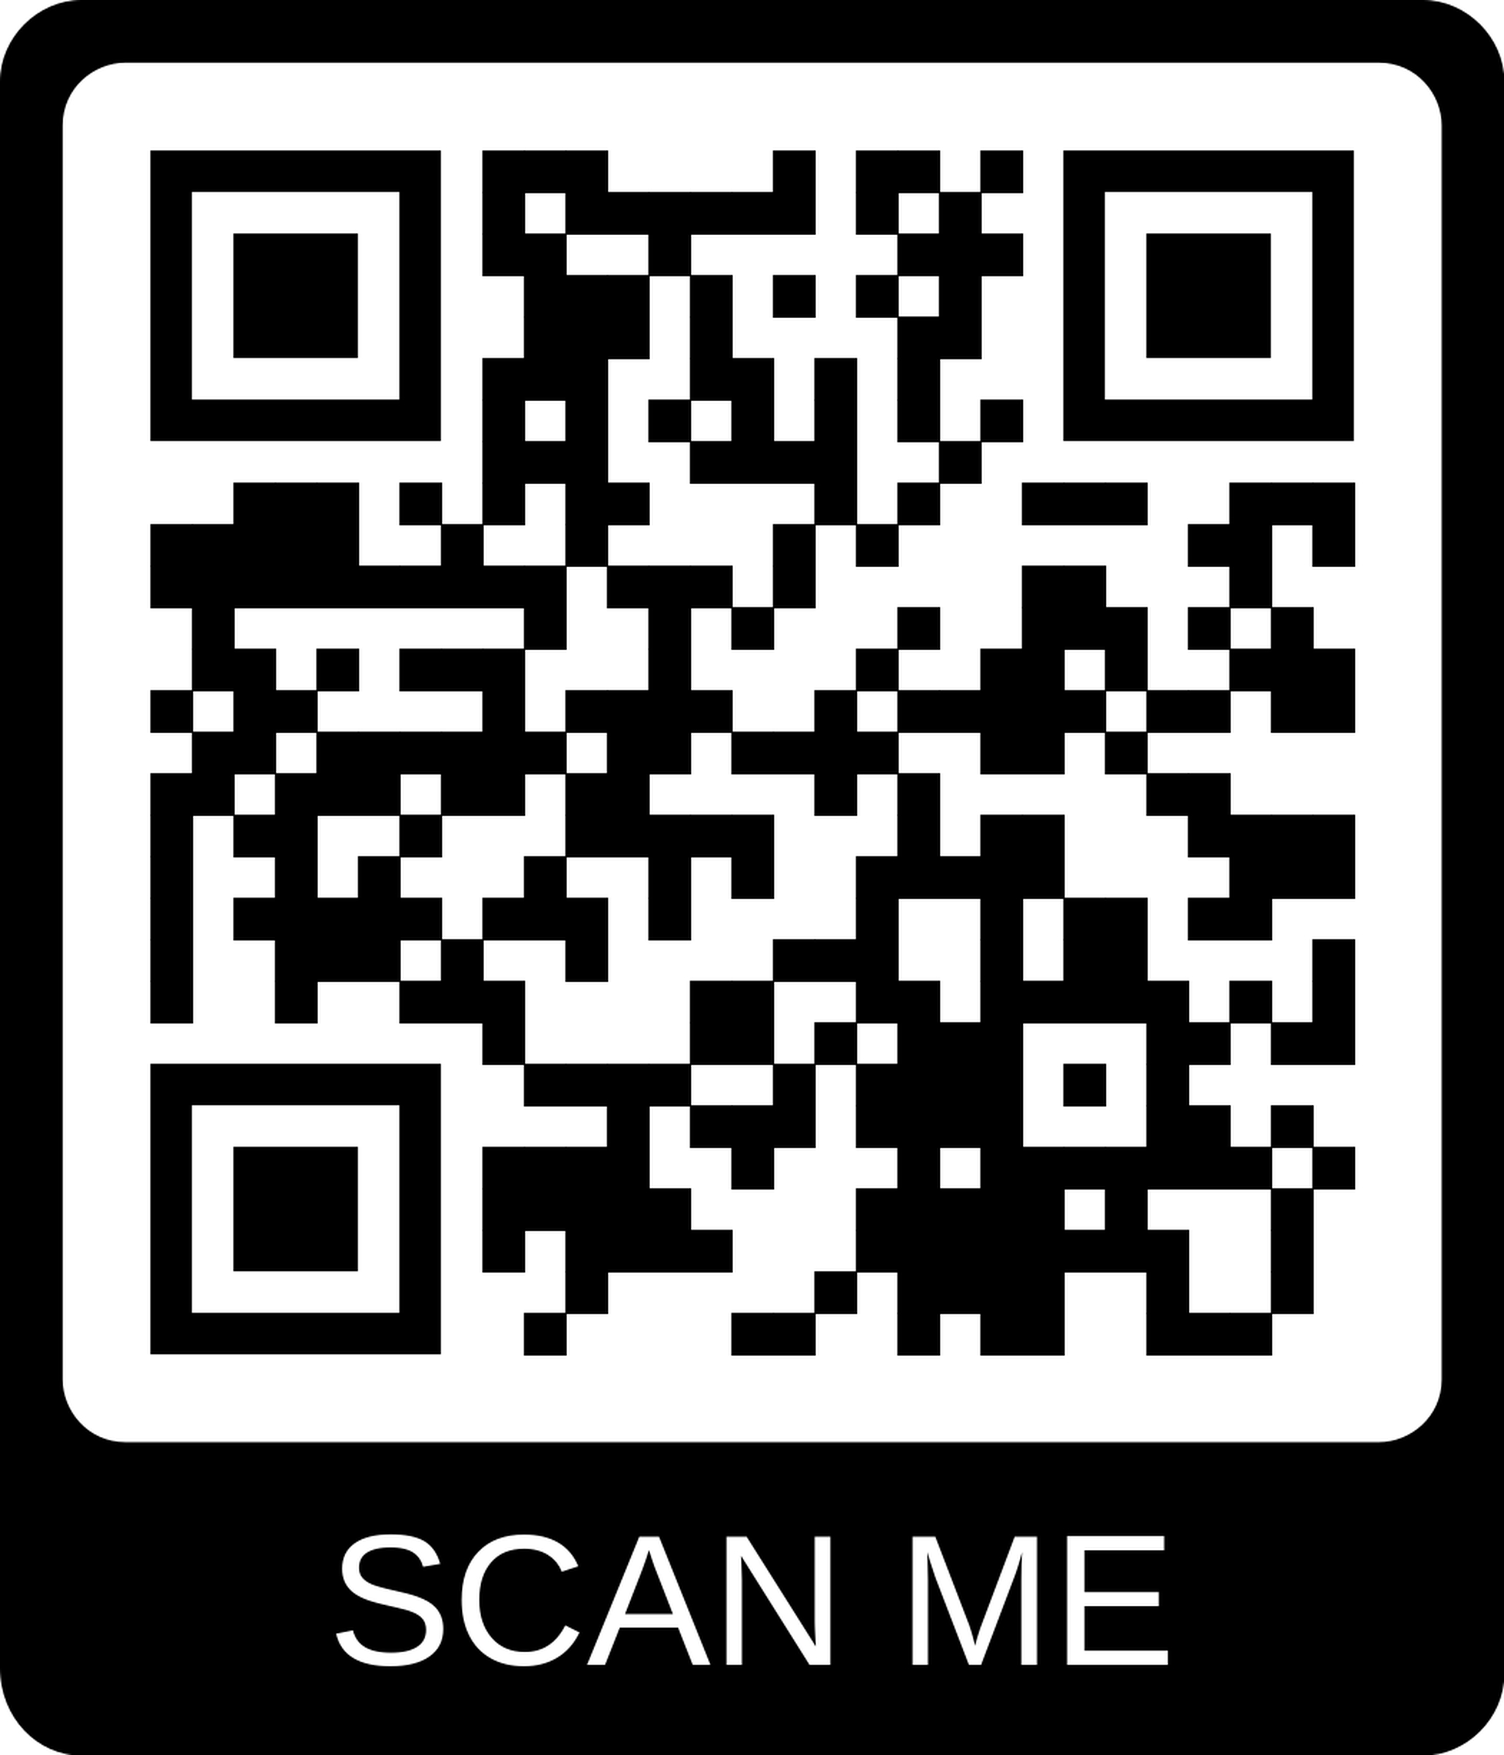
Protective
Orders:
The Basics
Different Types of Protective Orders
Emergency Protective Order
Lasts for 3 business days
Granted by the magistrate when the court is closed, such as at night and on holidays and weekends
A protective order is a piece of paper signed by a judge that is meant to protect you from someone who is hurting you or threatening to hurt you
Preliminary Protective Order
Lasts for 15 days but can be extended up to 6 months
Can be issued before or after the hearing for the “full” protective order
Full Protective Order
Lasts for 2 years or until the judge says it expires
Can be extended if you request another hearing before it expires
Scan here to view the full “Understanding Protective Orders in Richmond, VA”
booklet developed by Project LOTUS
Linking Outreach, Trust, Understanding and Safety for People with Disabilities

Slide 4
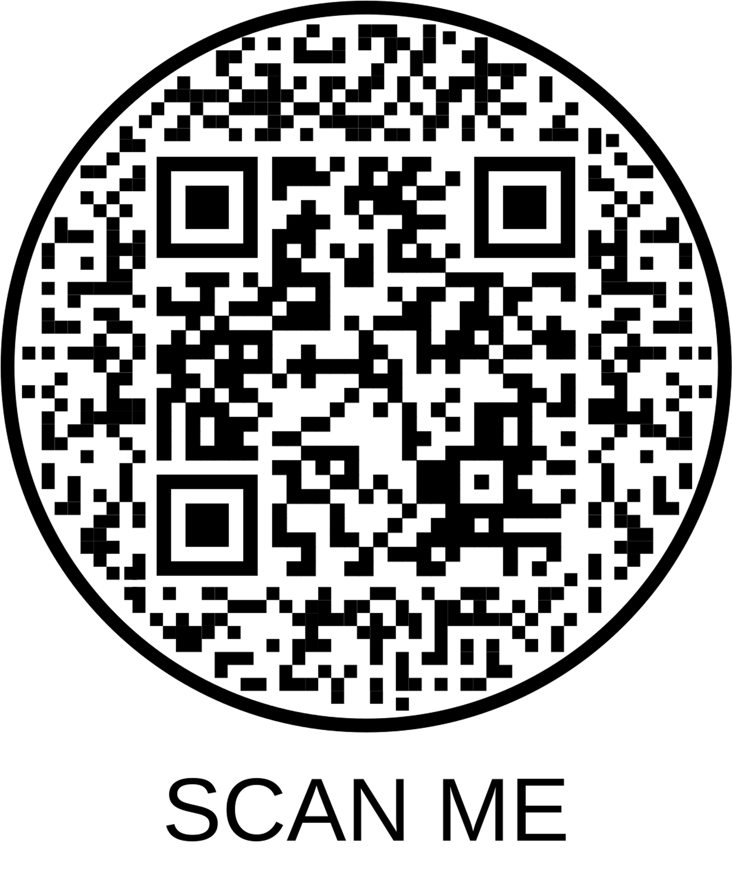
Family Abuse Protective Orders
Who can you be protected from?
Someone you share a child with | Your siblings, including half and step | Your boyfriend or girlfriend you lived with in the last year
Spouse, including ex’s | Your grandparents and grandchildren | The children of your boyfriend or girlfriend
Your parents or stepparents | Your spouse’s family | Legal custodian of a juvenile
Protection from spouse’s family requires you live together now
How can you get a Family Abuse Protective Order?
Forms can also be completed in person
1
Use the iCAN! Virginia Website to fill out the forms to take with you to court
2
Go to the Juvenile and Domestic Relations District Court Services Unit Intake Office located at:
1600 Oliver Hill Way, Richmond, VA 23219
Scan here to view the necessary paperwork for requesting for a protective order. Additional iCAN! Virginia Resources and the form can be found at the following website:
https://www.vacourts.gov/courtadmin/aoc/djs/programs/afapo/home

Slide 5
Non-Family Abuse Protective Orders
Who can you be protected from?
Your caregiver | Your neighbor | Your friend or coworker
Your boyfriend or girlfriend who you do not share a child with and did not live with in the last year | Anyone threatening to or hurting you, even if you do not know them | Anyone threatening to or hurting you who is not family
Applies to people who are not family or household members
How can you get a Non-Family Abuse Protective Order?
Forms can also be completed in person
1
Use the iCAN! Virginia Website to fill out the forms to take with you to court
2
Go to the Clerk’s Office of the General District Court located at:
800 E Marshall St, Richmond, VA 23219
Scan here to view the necessary paperwork for requesting for a protective order. Additional iCAN! Virginia Resources and the form can be found at the following website:
https://www.vacourts.gov/courtadmin/aoc/djs/programs/afapo/home

Slide 6
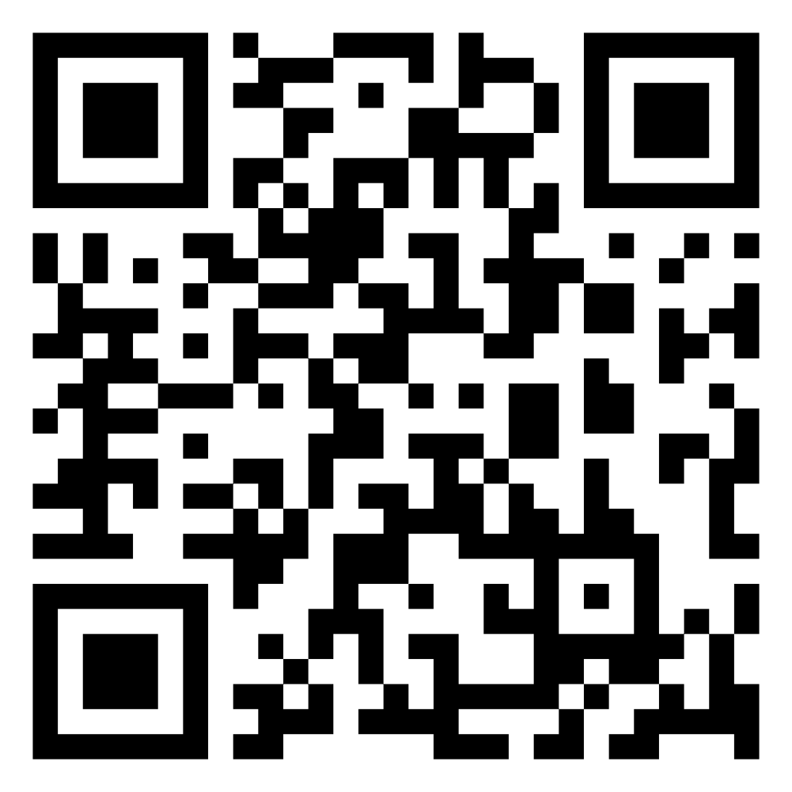
Protective Orders:
What to bring and what not to bring to the courthouse
DO's
DON'Ts
Your ID
Description of the person who hurt you
Birth certificate and social security numbers for children you would like protected
Evidence you have of being hurt, such as police reports, threatening messages, and hospital visits
Electronic devices, such as Smart watches, tape recorders, cell phones/cameras, headphones/Bluetooth devices
Weapons
Snacks or drinks, glass containers/bottles
Handcuff keys
Construction tools
Protective Orders:
What to do and what not to do at the courthouse
DO's
DON'Ts
Let the court know ahead of time if you need an accommodation for a disability, such as a listening device or sign language interpreter
Dress respectfully, as if you are going to a job interview
Smoke at the courthouse
Wear clothing with swear words or obscene pictures
Scan here to view the form to request accommodations. Other resources related to support for people with disabilities in the judicial system and this form can be found at the following website:
VA Courts Americans with Disabilities Act
(https://www.vacourts.gov/courts/ada/home)

Slide 7

Frequently Asked Questions
What if the court is closed when you need a Protective Order? You can request an Emergency Protective Order at the Magistrate’s Office located at: Richmond City Justice System, 1701 Fairfield Way, Richmond, VA 23219
What if you are under 18? You can still be protected by a Family or Non-Family Protective Order. Go to the Juvenile and Domestic Relations District Court Services Unit Intake Office located at: 1600 Oliver Hill Way, Richmond, VA 23219
What if you want a protective against a same-sex partner? You can still ask for a protective order, whether or not you are married to this same-sex partner. Same sex couples are seen in the Juvenile and Domestic Relations District Court located at: 1600 Oliver Hill Way, Richmond, VA 23219
Need more help?
Contact Richmond Victim Witness Services located at 800 E Marshall St, Richmond, VA 23219
804-646-7665
Scan here to view the full “Understanding Protective Orders in Richmond, VA”
booklet developed by Project LOTUS
Linking Outreach, Trust, Understanding and Safety for People with Disabilities

