Slide 1

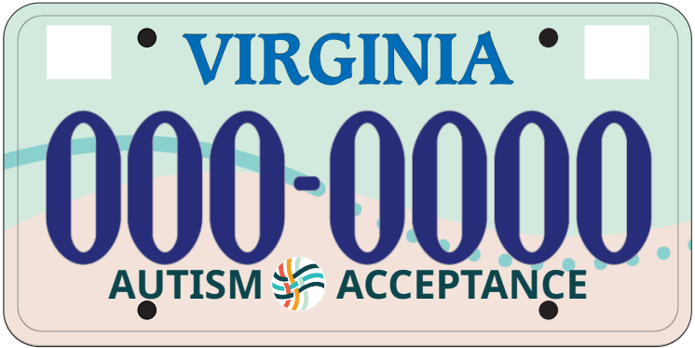
Drive the Conversation
Pre-Order Your Autism Acceptance Plate!
(PRELIMINARY DESIGN PENDING APPROVAL)

Slide 2
Rev Up Autism Acceptance Across Virginia!
The Virginia Autism Society Affiliates have teamed up to create a license plate supporting autism programs across the state.
Support autism programs by purchasing a special Virginia license plate through the DMV. $15 of the $25 fee goes directly to local autism services and resources. We need 450 orders by December 31, 2025 to make it happen!
Join us in driving autism acceptance across Virginia in just 2 easy steps!
Call to Action Video Placeholder
Suggested Video:
Scene opens with Person A on the computer as Person B approaches
Person B: “what are you doing”
Person A: “I’m supporting the autism community by pre-ordering the new plate”
Person B [shockingly]: “wow, isn’t that hard”
Person A: “nope, just need my VIN & Plate info, which is right here on my registration that I keep in my glove compartment”
Person B [shockingly]: “but isn’t it expensive”
Person A: “it’s the same price as if you were renewing your current plate; I have a specialized plate [holds up a cheeky fake plate], so it costs me $35”
Person B: “awesome, I want to use the computer next to preorder my plate”

Slide 3
Fill Out the DMV Form
Complete the online DMV license plate order form below. No need to download anything—just fill it in and submit. Be sure to have your VIN and current plate information handy. See an example.
Hyperlink popup box
Embedded Adobe DMV Form Placeholder
Connected to a secure document repository

Slide 4
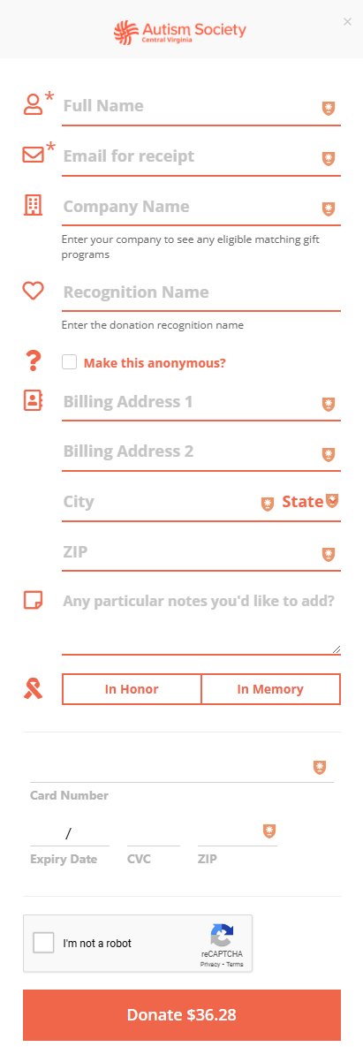
DMV Form Placeholder
SUBMIT
Submit Payment
Pay $25 for a standard plate or $35 for a personalized plate through the online form.
$25.94 $36.28
Standard Plate
Personalized Plate
To ensure that the full amount makes it to our organization, an additional fee ($0.94 for the standard plate or $1.28 for the personalized plate) was added to cover payment processing fees.
iframe or popup box for payment

Slide 6
Please note, if we are unable to make our goal of 450 preorders by December 31, 2025 the amount you paid (minus any processing fees collected) will be refunded to you.

Slide 7
Frequently Asked Questions
Expand All
Question
Question
Question
Answer would appear here, this is where the answer would be. Additional information, how to videos, and/or hyperlinks could also be added here to answer the question.
Question
Question
List of expanded questions and answers

Slide 8
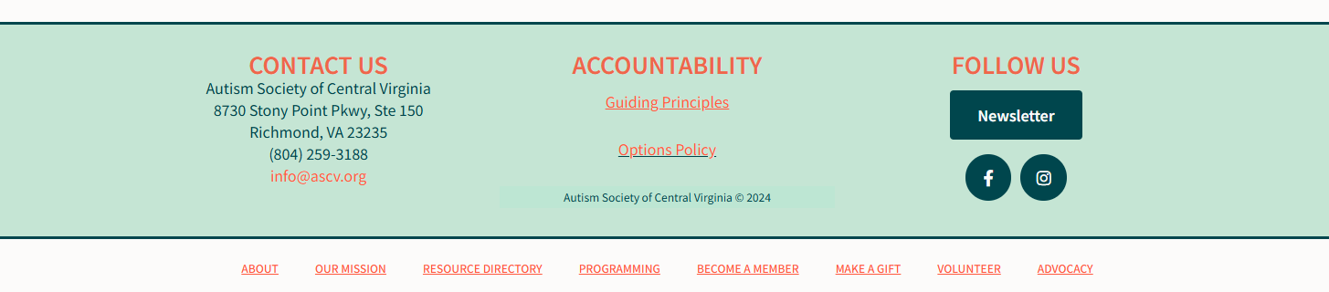
Question
Question
Special Thanks to Delegate Betsy Carr
A big thank you to Delegate Betsy Carr for her unwavering support in bringing the Virginia Autism Society license plate to the General Assembly. Her dedication and advocacy have been instrumental in making this project a reality for the autism community across Virginia!

Slide 9
Possible Questions & Answers – DMV’s FAQ
I’m still confused, where can I get more help? Who should I contact for more about Autism Acceptance Plate?
What does a new plate cost? Is there an annual fee?
How many characters can I have on my plate?
What if you don’t get enough pre-orders?
What’s next? Next steps?
What to expect?
How long will I wait for my plate? When will I receive my new plate?
What if I change my mind?
What if I’ve already renewed my plates?
Can I still have an accessible parking icon on my plate?
Do I have to be affiliated with the Autism Society to purchase a tag? | All Autism Awareness fans and friends are welcome to purchase a tag for their vehicle.
I see that the purchase may be tax deductible. What do I need to do for proof of purchase? | The DMV website provides an FAQ regarding how to determine if your license plate purchase is tax deductible.

