Slide 1
Successfully Implementing SDI and
knowing our students
Angela Beverly Special Education Teacher

Slide 2
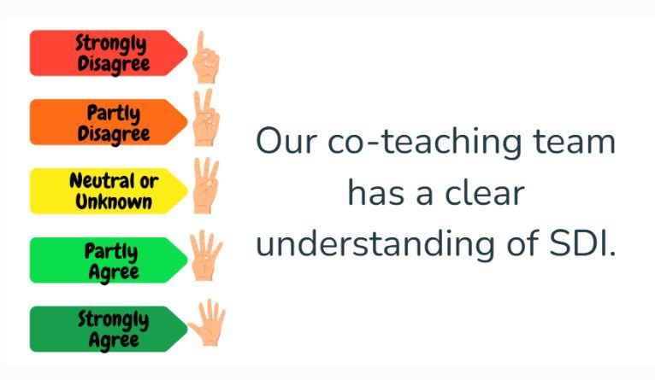

Slide 3
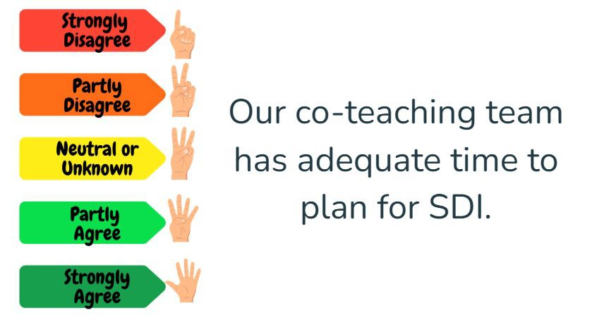

Slide 4
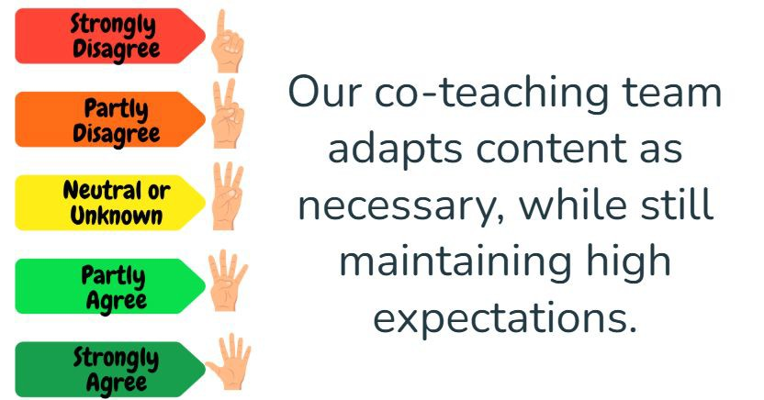

Slide 5
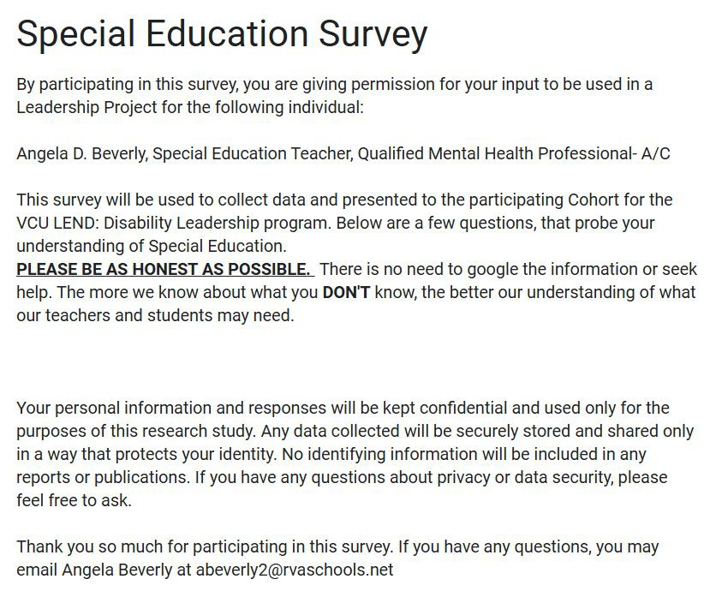

Slide 6
What district do you currently teach in?
What position do you hold in your school/district?
What do you already know about Special Education?
What do you look for when reading an IEP?
Do you know the difference between an IEP and a 504?
How prepared would you feel to service students with a diagnosis in Special Education?
Do you know what Specially Designed Instruction is, and how it's measured?
Do you know the difference in the 14 Special Education labels/categories?
What do you feel you need more information on, or what practices need to be modeled to succeed in providing
specially designed instruction to our students with disabilities. (Please answer both components of the question)

Slide 7
What is SDI

Slide 8
Specially Designed Instruction
CONTENT
METHODOLOGY
adapting the content, methodology, or delivery of instruction to address the unique needs of a student with a disability, ensuring access to the general curriculum.
DELIVERY

Slide 9
How do we think disabilities affect our students?

Slide 10
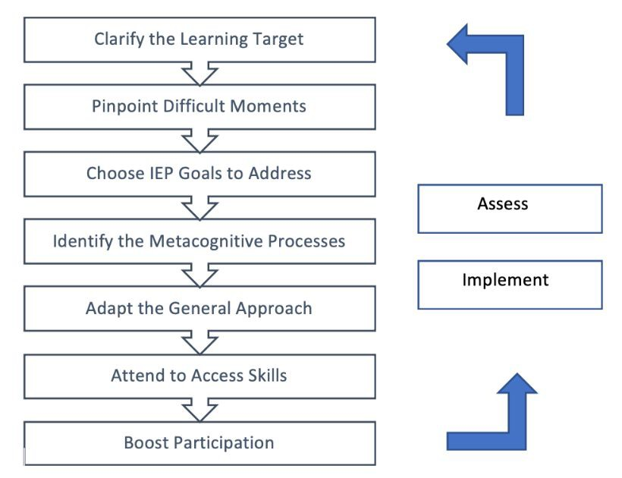
CTA, Virginia Department of Education, 2024

Slide 11
TURN AND TALK: CASE STUDIES
DAE

Slide 12
How can we learn our students by looking at their IEP or 504 plan?

Slide 13
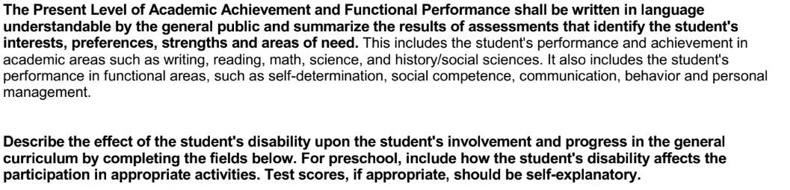
Present Levels of Performance

Slide 15
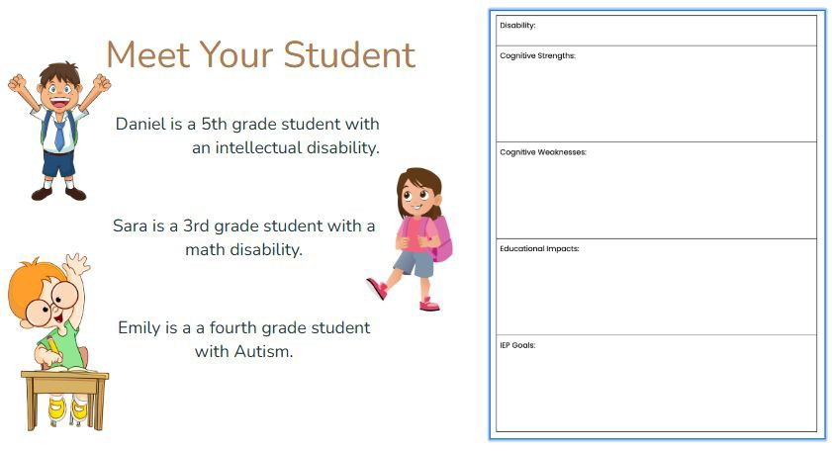

Slide 16
What do our parents want us to know about their students?
PARENT SURVEY RESULTS

Slide 17
CLOSING THOUGHTS
ANY QUESTIONS?

Slide 18
Askue-Collins, J., & Lynch, S. (2025, March 26). Specially designed instruction. Council for Exceptional Children. https://exceptionalchildren.org/topics/specially-designed-instruction
IEP & Instruction | Virginia Department of Education. (n.d.-a). https://www.doe.virginia.gov/programs-services/special-education/iep-instruction
Page 5: The IEP content. IRIS. (2025a, March 7). https://iris.peabody.vanderbilt.edu/module/iep01/cresource/q3/p05/
Page 6: High-quality PLAAFP statements. IRIS. (2025b, March 7). https://iris.peabody.vanderbilt.edu/module/iep01/cresource/q3/p06/#content
Page 7: Challenging, ambitious, measurable annual goals. IRIS. (2025c, March 7). https://iris.peabody.vanderbilt.edu/module/iep01/cresource/q3/p07/#content
Parentctrhub. (2022, April 21). Contents of the IEP. Center for Parent Information and Resources. https://www.parentcenterhub.org/iepcontents/
Specific disabilities | virginia department of education. (n.d.-b). https://www.doe.virginia.gov/programs-services/special-education/specific-disabilities
VDOE. (n.d.-a). Choosing a co-teaching model.png. https://drive.google.com/file/d/1V6I-zKiLHj_RaqbVTYtRfhx0yVMmPXw0/view VDOE. (n.d.-b). VDOE Impacts of disabilities.
https://docs.google.com/presentation/d/1mfbbVHdFISQw1sf32pmkB8mOtZsfAYardrYrPI4xukg/edit?slide=id.g2e39bcfa9be_0_0#slide=id.g2e3 9bcfa9be_0_0

