Slide 1





Tending the Garden
An Experiential Mindfulness Workshop for Parents and Caregivers of Young People with Autism
Joe Kreiter
Notes:
Hello my name is Joe Kreiter and this is my leadership project for the Spring 2025 LEND practicum course.
My discipline is social work.
The title of my presentation is...
A description of what you did for your leadership project
I created a workshop with the goal of introducing mindfulness, its relevance to young people with autism and the adults who care for them, and specific mindfulness practices. The target audience for this workshop is parents and caregivers of young people with autism.
Why you chose your
leadership project?
Mindfulness practice has been shown in academic research to benefit young people with autism and their families. I believe it is important to make awareness of mindfulness and mindfulness practices accessible to parents and caregivers who are searching for approaches to support themselves and the young people they care for.
The impact you hope your leadership project will have for children with disabilities 0-21 and their families
Parents and caregivers will increase their awareness and practice of mindfulness skills and possibly teach their children about mindfulness. Integrating mindfulness into family routines and culture will help reduce stress and enhance qualities of presence, awareness, and compassion for self and others among family members.
The workshop includes a mix of lectured-based content and experiential learning, specifically mindfulness practice and opportunities for reflection and discussion.

Slide 2
Tending the Garden: An Experiential Mindfulness Workshop for Parents and Caregivers of Young People with Autism
WELCOME!
We will begin in a few minutes.
While we wait, please introduce yourself in the chat.
You are invited to say your name, location, and one word (or more) about how you’re feeling in this moment.

Slide 3

Dropping in...
Breathing meditation: close your eyes or adopt a soft gaze; for the next few minutes, simply pay attention to your breath, tracking sensations such as the rising and falling of your chest or the air passing through your nostrils

Slide 4
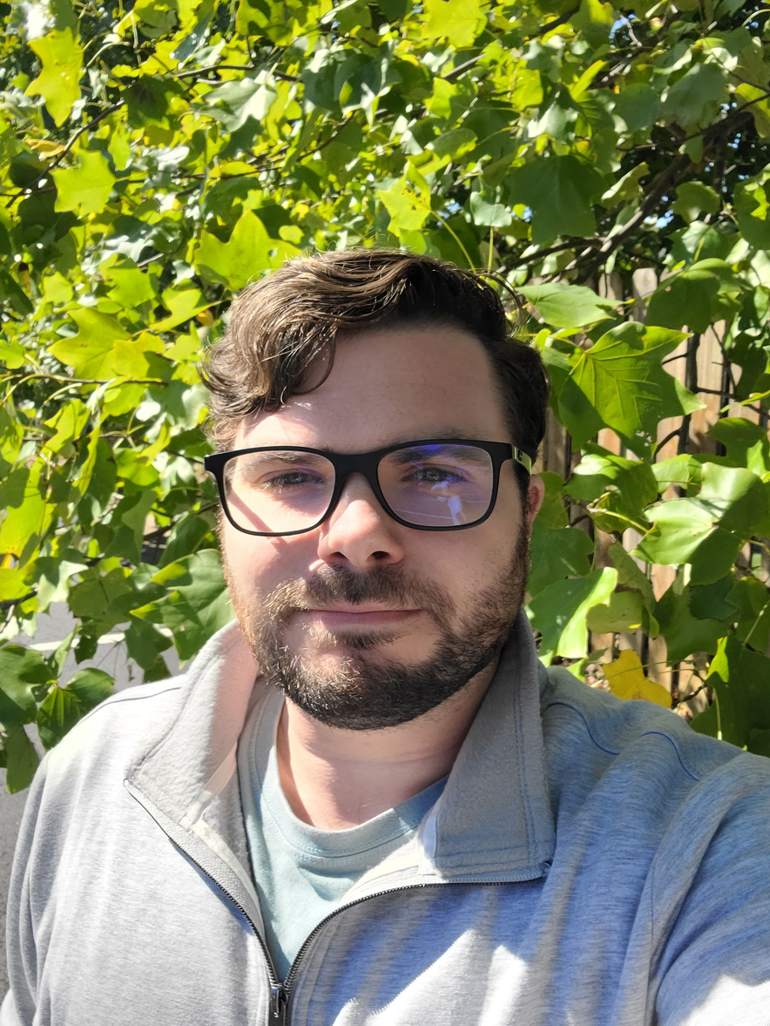
Meet your facilitator
Joe Kreiter (he/him)
MSW student & LEND trainee
Mindfulness meditation practitioner

Slide 5
Workshop goals
Introduce mindfulness practices that foster emotional resilience, reduce stress, and enhance connection
Explore relevance of mindfulness practice to young people with autism and their parents/caregivers
Support participants in developing their own relationship with mindfulness

Slide 6
Workshop structure
2.5 hours of mindfulness education, guided practice, and opportunities to reflect and share. There will be a break midway through.
There will be an optional Q&A after the closing section of the presentation. Please feel free to ask questions throughout the workshop as they arise. You can ask questions in the chat or unmute.

Slide 7
Agenda
I. Welcome and Introduction ← (we are here)
II. Demystifying Mindfulness & Caregiving
III. Recommended Mindfulness Practices
10 Minute Break
IV. Mindful Interacting
V. Closing and Integration
Followed by an optional Q&A session

Slide 8
Group agreements
Confidentiality
Speak from our own experience
Honor silence: allow for moments of pause between shares and silence during group practice
No fixing, saving, or advising
Take care ourselves!
Others?

Slide 9
Icebreaker Discussion
What brought you here today?
Feel free to participate in the chat or to come off mute!

Slide 10
Agenda
I. Welcome and Introduction
II. Demystifying Mindfulness & Caregiving ← (we are here)
III. Recommended Mindfulness Practices
10 Minute Break
IV. Mindful Interacting
V. Closing and Integration
Followed by an optional Q&A session

Slide 11
What is mindfulness?
“The awareness that emerges through paying attention on purpose, in the present moment, and nonjudgmentally to the unfolding of experience moment by moment.”
Jon Kabat-Zinn (2003)
paying attention
in the present moment
nonjudgmentally

Slide 12
Misconceptions about mindfulness
Mindfulness & meditation are the same thing
I have to be Buddhist to practice mindfulness
Mindfulness is all about relaxation
I can “use” mindfulness to get better at _____
Others?

Slide 13
Mindfulness practices
Meditation: sitting, standing, lying down, or walking
Mindful movement: yoga, t’ai chi, ecstatic dance
Mindful communication
Mindful eating or drinking
Almost anything that we do can be done mindfully!

Slide 14
The science of mindfulness
There is a large body of empirical evidence supporting the benefits of mindfulness for physical, mental, and emotional health.
Practicing mindfulness can help enhance emotional regulation, promote neuroplasticity, reduce stress hormones, and even boost immune function.

Slide 15
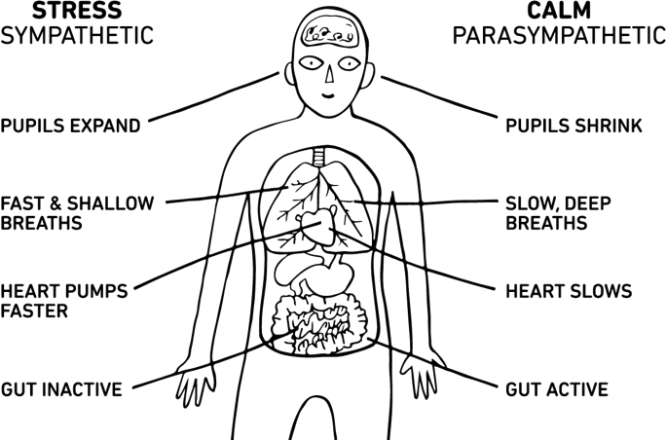
The parasympathetic nervous system
One way that mindfulness supports our bodies & minds is by activating our parasympathetic nervous system.
This is why practicing mindfulness often helps us feel calm.
Image credit: University of Utah (https://medicine.utah.edu/students/wellness/what-is-wellness/mindful-meditation/how-does-it-work)

Slide 16
Mindfulness & Autism
Clinical mindfulness-based interventions (MBIs) have been found to be effective and appropriate for young people with autism.
Many of the benefits of mindfulness counteract challenges that young people with autism commonly face.
Challenges associated with autism
Difficulty with emotional regulation
Alexithymia (“emotional blindness”), impaired interoception
Marginalization, oppression, internalized stigma
Rumination, experiential avoidance
Hyperarousal, sensory sensitivities
Benefits of mindfulness
Supports emotional regulation
Increases awareness
Supports self-compassion
Decreases rumination and avoidance
Produces physiological changes that support coping, resilience, and calm

Slide 17
Mindfulness & Caregivers
Mindfulness can support parents and caregivers for many of the same reasons that it may be helpful for the young people they care for. Reducing caregiver stress, cultivating self-compassion, and enhancing emotional attunement are among the primary benefits of mindfulness practice for caregivers.
Practicing mindfulness together is one way for caregivers and YPWA to engage in coregulation. Even if a YPWA does not practice mindfulness, having a caregiver who does has been shown to be beneficial to the young person. This is because caregivers who regularly practice mindfulness tend to be more calm, attuned, flexible, and aware as a result of their mindfulness practice.
Parents and caregivers who practice mindfulness can also effectively teach mindfulness skills and practices to the young people they care for.

Slide 18

“The most precious gift we can offer others is our presence. When
mindfulness embraces those we love, they will bloom like flowers.”
Thich Nhat Hanh (1996)

Slide 19
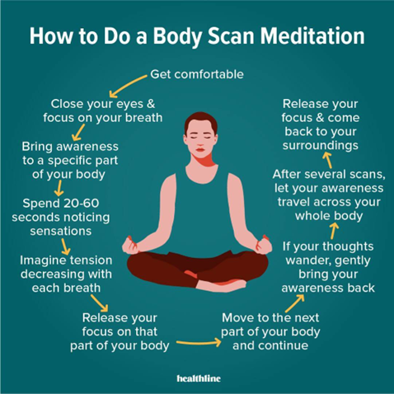
Experiential practice: Body scan meditation
Image credit: Healthline.com (https://www.calmsage.com/mindfulness-body-scan-meditation/)

Slide 20
Agenda
I. Welcome and Introduction
II. Demystifying Mindfulness & Caregiving
III. Recommended Mindfulness Practices ← (we are here)
10 Minute Break
IV. Mindful Interacting
V. Closing and Integration
Followed by an optional Q&A session

Slide 21
Self-compassion
Self-compassion refers to the practice of extending the same kindness, understanding, and care to ourselves that we would to a loved one.
Discussion: Are there times you have struggled with self-compassion as a caregiver to a young person with autism? What helps you to access compassion for yourself when you need it most?

Slide 22

Loving-kindness meditation
Loving-kindness, or mettā (Pali), is a Buddhist term that refers to a practice of cultivating benevolence, goodwill, and compassion towards oneself and others.
Mettā meditation can be used to promote these qualities in our relationships with ourselves and with those we care for.

Slide 23
Grounding & emotional regulation
Mindfulness practices that can support grounding and emotional regulation include:
Body scan meditation
Walking meditation
Progressive muscle relaxation
Breathwork: box breathing, 4-7-8 breathing, breathing meditation
5-4-3-2-1 grounding technique

Slide 24
Mindfulness during challenging times
“Between stimulus and response there is a space. In that space is our power to choose our response. In our response lies our growth and our freedom.”
Stephen R. Covey (origin disputed), on the work of Viktor Frankl.
Practices
Taking a mindful pause
RAIN meditation

Slide 25
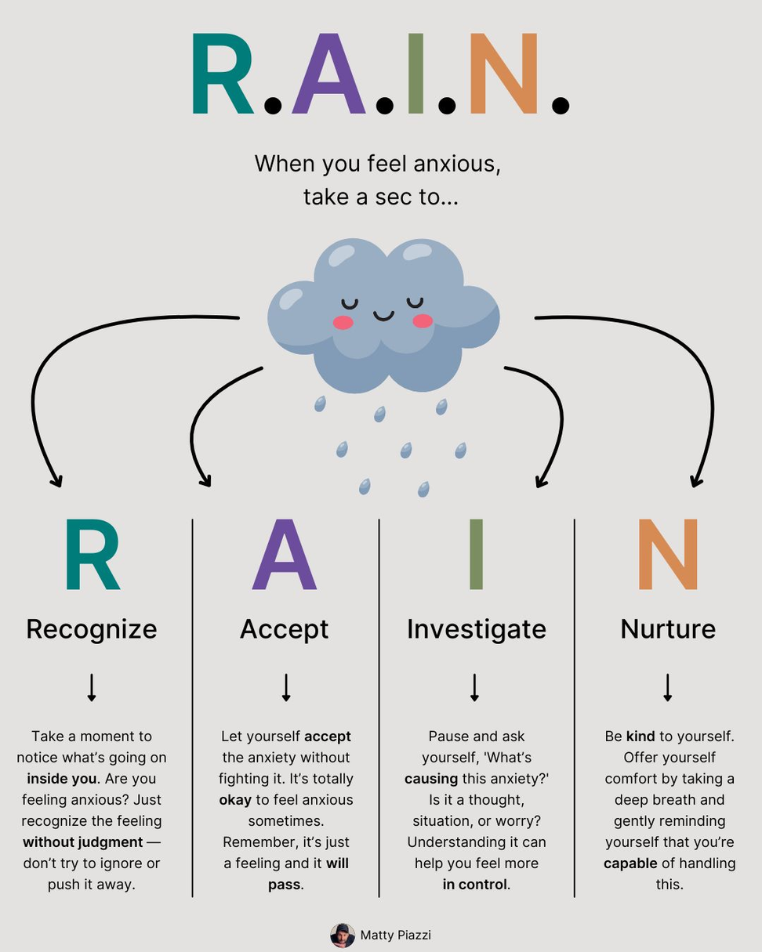
Image credit: Matty Piazzi (https://www.linkedin.com/posts/mattypiazzi_how-to-handle-anxiety-at-work-today-hamia-activity-7264622464540819456-31tP)

Slide 26
Reflect
What are some of your personal stress triggers? What practices might you use to respond to them more mindfully?
Feel free to participate in the chat or to come off mute!

Slide 27
Experiential practice: Chair yoga

Slide 28
Break time 🙂
See you back in 10 minutes!

Slide 29
Agenda
I. Welcome and Introduction
II. Demystifying Mindfulness & Caregiving
III. Recommended Mindfulness Practices
10 Minute Break
IV. Mindful Interacting ← (we are here)
V. Closing and Integration
Followed by an optional Q&A session

Slide 30
Practicing mindful interactions
Presence and attunement are the hallmarks of mindful interactions. When interacting mindfully, we balance our attention between the other person and our own internal experience. We remain aware and responsive to the experiences that arise moment by moment.
During the interaction, we adopt an attitude of curiosity and acceptance towards the other person and our own internal experience. It is important not to judge what arises--even if judgement itself is showing up!

Slide 31
Mindful listening & nonverbal connection
Mindful listening is one part of mindful communication. It involves being fully present and attentive to the speaker, both verbally and nonverbally, without judgment or interruption. This can deepen understanding and connection between the speaker and listener.
Nonverbal connection refers to the bond formed between interacting people through unspoken cues like body language. It is just as important, if not more so, as verbal communication. This is especially true when interacting with YPWA who may use less verbal communication.

Slide 32
Tips for teaching mindfulness to young people with autism
Practice mindfulness yourself
Make mindfulness fun, not a chore or punishment
Do not introduce new mindfulness skills/practices during challenging moments
Stick to a routine around mindfulness practice as much as possible
Set up a comfortable space to practice
Allow adaptations
Involve them in decision-making around mindfulness practice
Share openly about your experiences with mindfulness
Encourage them to share about their experiences

Slide 33
Partner exercise: Mindful communication
Speaker prompt: share thoughts and reflections about mindful caregiving including potential challenges, applications, personal success stories, etc.
Partner A speaks for five minutes while partner B listens; then partner B speaks for five minutes while partner A listens. Both partners then have 5 minutes to share reflections with each other (15 minutes total)
We will then come back together to share reflections with the larger group

Slide 34
Agenda
I. Welcome and Introduction
II. Demystifying Mindfulness & Caregiving
III. Recommended Mindfulness Practices
10 Minute Break
IV. Mindful Interacting
V. Closing and Integration ← (we are here)
Followed by an optional Q&A session

Slide 35
Integrating mindfulness into daily routines
If possible, practice formal meditation daily for at least 10-20 minutes. It helps to practice at the same time every day to reinforce the habit.
Other tips for integrating mindfulness throughout your day:
Take a few deep breaths throughout the day as a mini “reset”
Practice mindfulness through your morning routine; i.e., when brushing your teeth, drinking coffee, or making breakfast
Practice mindfulness while doing chores such as folding laundry or doing the dishes
Practice “present moment talk” with loved ones
Remember: presence over perfection
Go easy on yourself

Slide 36

Closing practice: Silent meditation
Consider... “What am I taking away from today’s workshop?”

Slide 37
Thank you!
This is the end of the presentation. We will now turn to Q&A for any who wish to stay and ask questions.
Have a wonderful day!

Slide 38
References
Beck, K. B. (2025). Mindfulness: a promising therapeutic approach for autistic people.
Beck, K. B., Conner, C. M., White, S. W., & Mazefsky, C. A. (2020). Mindfulness “here and now”: Strategies for helping adolescents with autism. Journal of the American Academy of Child & Adolescent Psychiatry, 59(10), 1125-1127.
Grossman, P., Niemann, L., Schmidt, S., & Walach, H. (2004). Mindfulness-based stress reduction and health benefits: A meta-analysis. Journal of Psychosomatic Research, 57, 35-43.
Heifetz, M. & Dyson, A. (2017). Mindfulness-based group for teens with developmental disabilities and their parents: A pilot study. Mindfulness, 8, 444-453. DOI 10.1007/s12671-016-0616-7
Kabat-Zinn, J. (2003). Mindfulness-based interventions in context: Past, present, and future. Clinical
Psychology: Science and Practice, 10(2), 144–156. https://doi.org/10.1093/clipsy.bpg016
Loftus, T., Mathersul, D. C., Ooi, M., & Yau, S. H. (2023). The efficacy of mindfulness-based therapy for
anxiety, social skills, and aggressive behaviors in children and young people with autism spectrum disorder. Frontiers in Psychiatry, 14. https://doi.org/10.3389/fpsyt.2023.1079471
Nhất Hạnh, Thích. (1996). Be still and know : reflections from Living Buddha, living Christ. Riverhead Books.
Niazi, A.K. & Niazi, S.K. (2011). Mindfulness-based stress reduction: a non-pharmacological approach for chronic illness. North American Journal of
Medical Sciences, 3(1), 20-23. doi: 10.4297/najms.2011.320
Poquerusse, J., Pagnini, F., & Langer, E. J. (2021). Mindfulness for autism. Advances in Neurodevelopmental Disorders, 5, 77-84. https://doi.org/10.1007/s41252-020-00180-9

