Slide 1
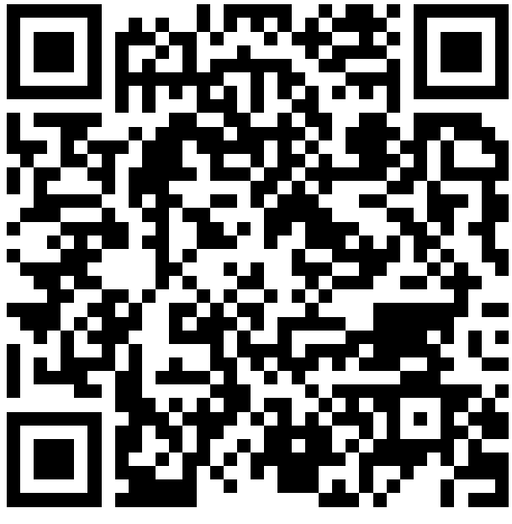
Turning a Page for the Future: Language Supports and Shared Readings
Billy Holden Allen B.S.
Dr. Erin Wallace, Ph.D., CCC-SLP
Longwood University Department of Communication Sciences and Disorders
INTRODUCTION
RESULTS
DISCUSSION & LIMITATIONS
Caregivers notably impact the language development of their children (Loi et al., 2017; McKeown, 2019). While language learning occurs through a plethora of mediums, shared readings between caregivers and children can positively impact initial language development as well as general growth (Breitfeld et al., 2021, López-Escribano et al., 2021). This dynamic is extremely critical as high-quality language presented within shared readings greatly impacts later speech, social-emotional behavior, reading comprehension, and vocabulary proficiencies (Ece Demir-Lira et al., 2019; Massaro, 2017).
The purpose of this study is to investigate the strengths and weakness of language supportive strategy usage during shared readings by caregivers. This study also makes recommendations for improvement strategies to facilitate language development.
IMPLICATIONS / (TITLE)
The respondents indicated a high awareness of the importance of reading with over 95% stating that reading is “extremely important” to a child’s development. The average time spent reading every week was 3.5 hours. The majority of readers were mothers, followed by fathers. Despite indicating an understanding of the importance of shared readings, the usage of language supportive strategies such as “wh-questions, sounding out words, expanding on story content, and generalizing content only occurred “occasionally.”
Regarding limitations, the overall composition of the sample for this study was over 95% “Caucasian.” Also, 80% self-identified as being “middle” or “upper middle class.” Overall diversity concerning racial/ethic backgrounds and SES levels was limited.
METHODS
IMPLICATIONS
RESEARCH QUESTIONS
Caregivers demonstrated notable recognition of strategies that can be implemented during shared readings. Despite this awareness, the respondents only used these strategies “occasionally.” Strategies that were easier to implement, as compared to more advanced/involved strategies such as generalizing and expansion, were used more frequently despite not being as conducive for language development.
Due to participant demographics, a more inclusive sample could shed further light on areas highlighted by this study. Regardless of the sample characteristics, the results illustrate that high-quality, language supportive strategies are used less frequently by caregivers during shared readings. Education and outreach opportunities that target language supportive strategies could positively impact caregivers’ knowledge of optimal reading strategies and improve child language outcomes.
What language-supportive strategies are used by caregivers?
What language-supportive strategy is most frequently used by caregivers?
Do caregivers have a knowledge of how to use language-supportive strategies?
METHOD
Study Design: Quantitative survey using snowball and convenience sampling
Inclusion Criteria: English speaking caregivers who read to their child (Ages 1-7)
Data Collection: 32 question survey that collected reading practices, views, and demographic data
Reliability: Survey questions were devised based on published questionnaire assessing language development and parental practices in an article published in Language, Speech, Hearing Services in Schools (Boudreau, 2005)
Validity: Survey was reviewed by licensed SLPs with doctoral degrees and institutional IRB members
REFERENCES AND SURVEY
References
Survey

