Slide 1
Learn the Signs Act Early Research & Learning
Rebecca Stickler, Family LEND Trainee
Va-LEND Leadership Project
Spring Semester 2024
*Slides have a background of young children and a dog playing outside. This is for decorative purposes to emphasize my project was working with Early Childhood systems.
Notes:
Hello. I am Rebecca Stickler, a Va-LEND Trainee in the Family discipline. My leadership project was researching how parents and caregivers look for information about the development of their children and learning about the CDC’s Learn the Signs Act Early project that includes a variety of resources for families and professionals to be aware of developmental milestones of babies, toddlers and young children birth to age 5. These milestones are what a young child may be doing at different ages. If there is a concern about not meeting a developmental milestone, one can have a conversation with their child’s doctor.
The slides shown in my presentation have a background of young children and a dog playing outside. The decorative slides are to emphasize my project was working with Early Childhood systems.

Slide 2
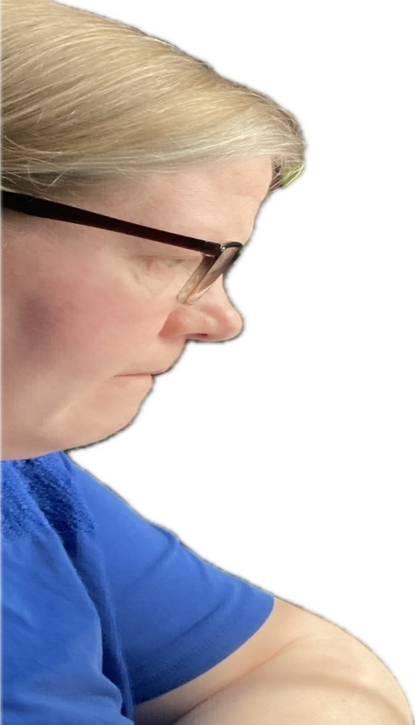
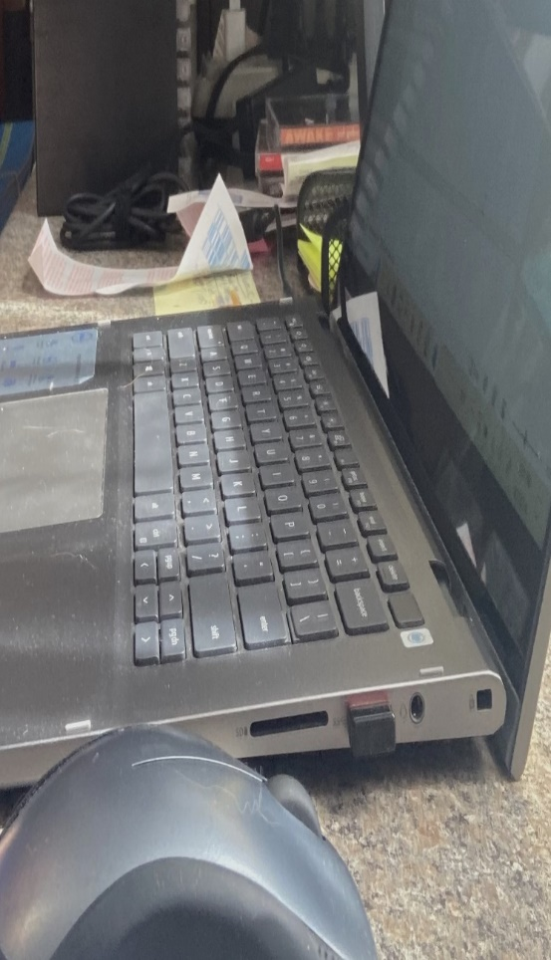
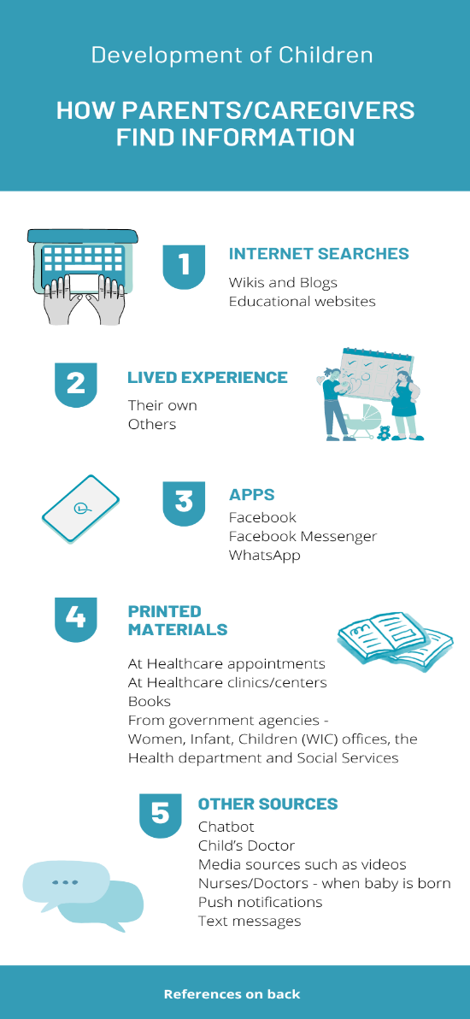
Planning Research Results
Notes:
This slide shows a close-up picture of my face looking down at a computer on a desk. The last picture shows the infographic I created with images and pictures related to my research of how parents and caregivers look for developmental information.

Slide 3
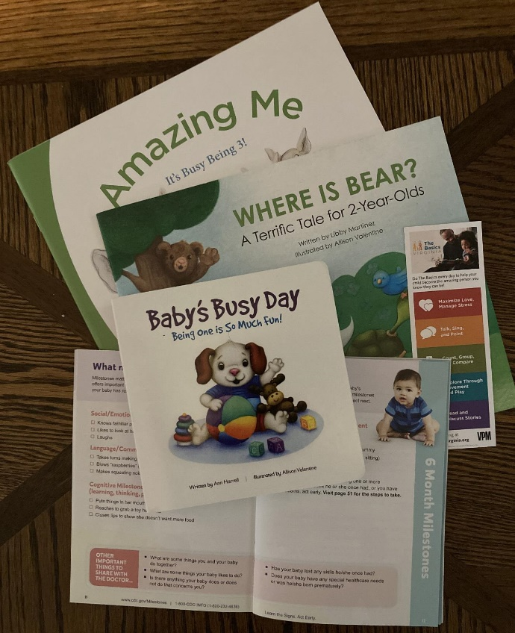
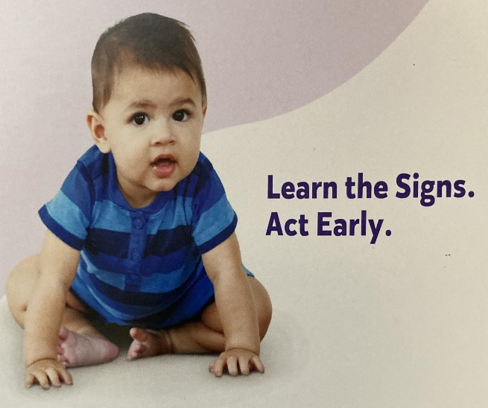
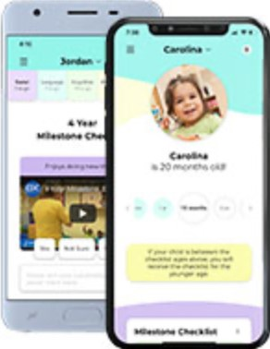
Stakeholder Meeting and Focus Group
Track your child’s milestones with CDC’s FREE Milestone Tracker App, now available in Spanish.
Notes:
I participated with stakeholders of Early Childhood systems to learn and discuss how they are caring for young children in Virginia and how the Learn the Signs Act Early materials can reach families of young children throughout Virginia.
This slide shows materials used in my learning. This first picture shows a baby sitting on the floor with the words that read Learn the Signs. Act Early. The picture in the middle shows a bookmark and several books for different ages of young children. In each book there are milestones a child may show at each age and activities to encourage development. The last picture shows 2 cellphones with images of contents on the Milestone Tracker app of which a family can download the app in English or Spanish and use to track their children’s development.
I chose my project to familiarize myself with Learn the signs act early materials and Early Childhood systems impacting families across Virginia.
I hope my involvement and research informs systems to provide a variety of materials to meet the diverse needs of families, I hope that Early Childhood systems can better screen babies and toddlers early so those who need it can get services through programs like Early Intervention that helps babies and toddlers catch up developmentally with their peers by the time they enter school.

Slide 4
References
Arshanapally, S., Green, K., Slaughter, K., Muller, R., & Wheaton, D. (2022). Use of a paid digital marketing campaign to promote a mobile health app to encourage parent-engaged developmental monitoring: Implementation study. JMIR Pediatrics and Parenting, 5(2), e34425–e34425. https://doi.org/10.2196/34425
Bryan, M. A., Evans, Y., Morishita, C., Midamba, N., & Moreno, M. (2020). Parental perceptions of the internet and social media as a source of pediatric health information. Academic Pediatrics, 20(1), 31–38. https://doi.org/10.1016/j.acap.2019.09.009
Centers for Disease Control and Prevention. (n.d.). Get free “Learn the Signs. Act Early” materials. https://www.cdc.gov/ncbddd/actearly/freematerials.html#Children
Centers for Disease Control and Prevention. (n.d.). Learn the signs act early. https://www.cdc.gov/ncbddd/actearly/index.html
Gallagher, P. A., Greenberg, D., Campbell, J. M., Stoneman, Z., & Feinberg, I. Z. (2019). Early identification and connection to services among urban parents who have low income and low-literacy skills. Focus on Autism and Other Developmental Disabilities, 34(2), 97–106. https://doi.org/10.1177/1088357618794913
Harvey, S., Memon, A., Khan, R. & Yasin, F. (2017). Parent’s use of the Internet in the search for healthcare information and subsequent impact on the doctor–patient relationship. Irish Journal of Medical Science (1971–), 186, 821–826. https://doi.org/10.1007/s11845-017-1555-6
Jäggi, L., Aguilar, L., Alvarado Llatance, M., Castellanos, A., Fink, G., Hinckley, K., Huaylinos Bustamante, M.-L., McCoy, D. C., Verastegui, H., Mäusezahl, D., & Hartinger Pena, S. M. (2023). Digital tools to improve parenting behaviour in low–income settings: A mixed–methods feasibility study. Archives of Disease in Childhood, 108(6), 433–439. https://doi.org/10.1136/archdischild-2022-324964 https://adc.bmj.com/content/archdischild/early/2023/03/27/archdischild-2022-324964.full.pdf
Notes:
These last 2 slides include my references.

Slide 5
References, continued
Orlando, J. M., Cunha, A. B., Alghamdi, Z., & Lobo, M. A. (2023). Information available to parents seeking education about infant play, milestones, and development from popular sources. Behavioral Sciences, 13(5), 429. https://doi.org/10.3390/bs13050429
Safadi, R. R., Ahmad, M., Nassar, O. S., Alashhab, S. A., AbdelKader, R., & Amre, H. M. (2016). Jordanian mothers’ knowledge of infants’ childrearing and developmental milestones. International Nursing Review, 63(1), 50–59. https://doi.org/10.1111/inr.12185
Saleh, S., AlGhfeli, M., Al Mansoori, L., Al Kaabi, A., Al Kaabi, S., & Nair, S. C. (2023). Knowledge and awareness among mothers regarding early childhood development: A study from the United Arab Emirates. Curēus (Palo Alto, CA), 15(4), e37027–e37027. https://doi.org/10.7759/cureus.37027
Stickler, R. (2024). How parents/caregivers find info about development [Infographic]. Canva.com https://www.canva.com/design/DAGBYYlCZ7Q/I5yhYGBZAyf4OJJk7e471w/view?utm_content=DAGBYYlCZ7Q&utm_campaign=designshare&utm_medium=link&utm_source=editor
Stickler, R. (2024). [Photograph of a computer on a desk]. Personal cellphone.
Stickler, R. (2024). [Photograph of Learn the Signs. Act Early, materials]. Personal cellphone.
Stickler, R. (2024). [Selfie Photograph of side view of a woman’s face]. Personal cellphone.
Wagner, L., Corona, L., Khan, N., Hooper, M., Dixon, A., Munoz Lavanderos, A., Zheng, Z., Sarkar, N., Sarkar, N., & Warren, Z. (2023). Development of an app for tracking family engagement with Early Intervention services: Focus groups and pilot evaluation study. JMIR Human Factors, 10, e45957–e45957. https://doi.org/10.2196/45957
Notes:
There are some great things happening in Virginia now and in the future that will positively affect families of young children. I am excited to see what’s coming…
Thank you.

