Slide 1
NEURODIVERSITY 101
Presented by: Sarah Alban, Helen Anderson, and Jordana Weiss

Slide 2
Disclosures
We are 2nd-year genetic counseling M.S Students within the VA-LEND Program at VCU.
None of us identify as neurodiverse/neurodivergent.
We understand the limitations this imposes on our presentation, but we hope it may still be beneficial.

Slide 3
WHAT IS NEURODIVERSITY?

Slide 4
Definitions
The American Psychiatric Association (APA) defines neurodiversity as:
“A concept that regards individuals with differences in brain function and behavioral traits as part of normal variation in the human population.”
While there are many definitions of neurodiversity, it is almost always used as an umbrella term highlighting differences in the way people think, behave, and communicate.
American Psychiatric Association. (2022, April 11). Exploring a strengths-based approach to neurodiversity.

Slide 5
Definitions
The following are often included under the umbrella of neurodiversity:
Autism
Dyslexia
ADHD
Dyspraxia
Dyscalculia
Dysphonia
Tourette syndrome
Synesthesia
OCD
Anxiety
Neurodiversity Hub. (2024, March 27). https://www.neurodiversityhub.org/
American Psychiatric Association. (2022, April 11). Exploring a strengths-based approach to neurodiversity.
Notes:
For example, some of these conditions are also formally considered learning differences/neurodevelopmental disabilities (NDD). Establishing a diagnosis can help individuals qualify for EIS, IFSPs, 504 Plans, IEPs, and supportive therapies (ABA, speech, OT, PT) among other resources and services. Neurodiversity is closely related to cognitive diversity, but incorporates a broader range of conditions. This definition of neurodiversity includes autism, dyslexia (difficulties with reading, writing and spelling), ADHD, dyspraxia (problems with manual dexterity and coordination), dyscalculia (difficulties with math and calculation), dysphonia (disorders of the voice), Tourette syndrome, synethesia1 and other behavioral and neurobiological differences.

Slide 6
Definitions
Neurodiversity is not:
A formal diagnosis with DSM-5 or other clinical criteria
A synonym for autism
A synonym for intellectual disability (ID)
A synonym for developmental delay or global developmental delay (DD/GDD)
A uniform experience
If this term is so broad, why is it even helpful?
Neurodiversity Hub. (2024, March 27). https://www.neurodiversityhub.org/
American Psychiatric Association. (2022, April 11). Exploring a strengths-based approach to neurodiversity.

Slide 7
Definitions
Using terms like neurodiversity can:
Normalize conditions
Reframe as a difference, not a defect
Support patient self-esteem
Help people find and establish community
People with similar lived experiences may have different diagnoses
Help people access supports and resources
Beyond 504 Plans and IEPs
Neurodiversity Hub. (2024, March 27). https://www.neurodiversityhub.org/
American Psychiatric Association. (2022, April 11). Exploring a strengths-based approach to neurodiversity.
Notes:
Children were defined as having ASD if sufficient social and behavioral deficits and/or an ASD diagnosis were noted in health and/or education records. Among 4,498 children, 1,135 (25%) had ASD indicators without having an ASD diagnosis. Of those 1,135 children without a documented ASD diagnosis, 628 (55%) were not known to receive ASD services in public school. Factors associated with not having a clinical diagnosis of ASD were non-White race, no intellectual disability, older age at first developmental concern, older age at first developmental evaluation, special education eligibility other than ASD, and need for fewer supports. These results highlight the importance of reducing disparities in the diagnosis of children with ASD characteristics so that appropriate interventions can be promoted across communities.

Slide 8
“As American English speakers, we are perfectly at liberty to use whatever language we want; we just have to know that our words reveal our social and moral beliefs to some extent.”
Amanda Montell, Wordslut: A Feminist Guide to Taking Back the English Language

Slide 9
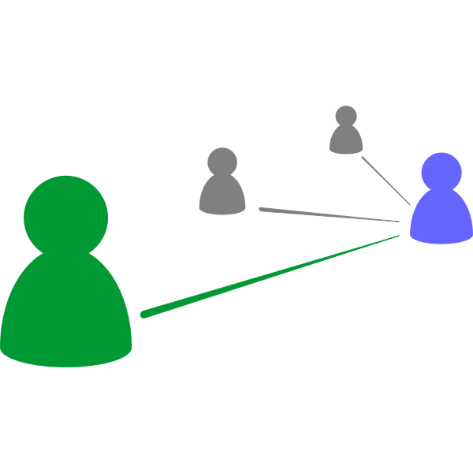
Models of Disability
The language we use to talk about human differences both depends on and shapes the way we view these differences.
Neurodiversity and disability may be viewed through many lenses, each with strengths and weakness.
Three common models of disability are:
The moral model
The medical model
The social model
Olkin, R. (2002). Could you hold the door for me? Including disability in diversity. Cultural Diversity and Ethnic Minority Psychology, 8, 130-137.
Notes:
Each person and family may view their diagnosis through a different lens.
Understanding how our patients perceive their diagnoses can help us better tailor our care to support them
Culturally competent care

Slide 10
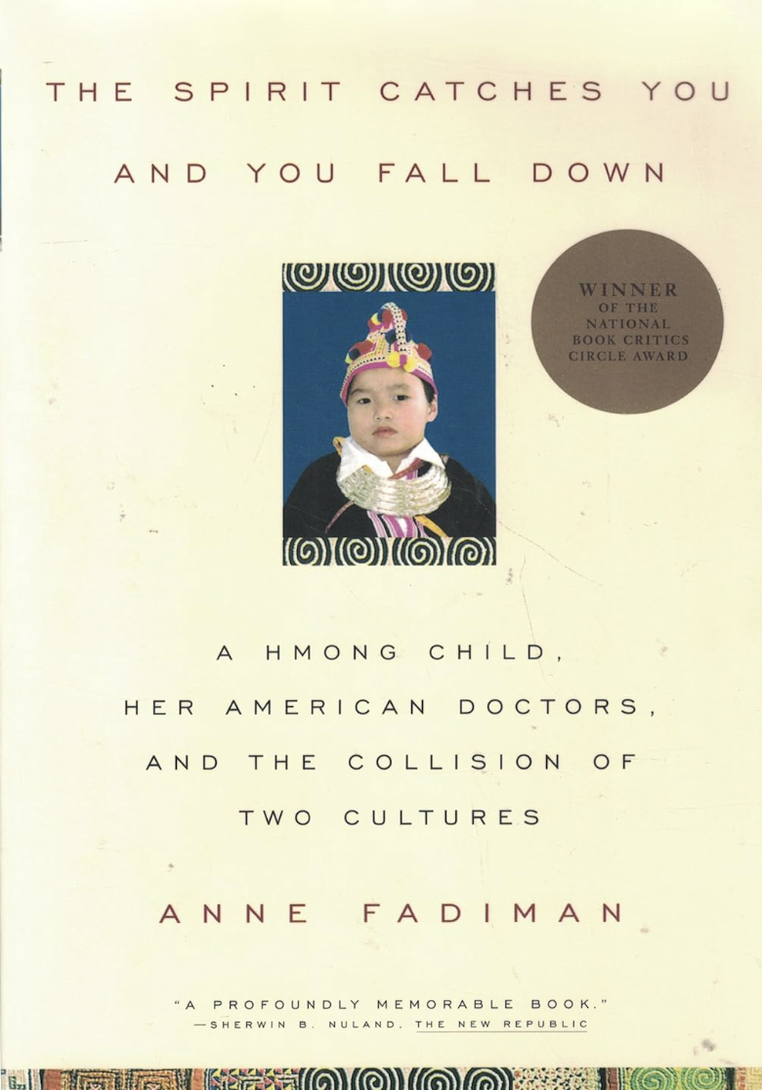
The Moral Model
Disability possesses meaning about a person’s or family’s character, deeds, thoughts, and/or karma
Common worldwide and in the media
Disability may be seen as:
A weakness or mark of wrongdoing with stigma, shame, and/or blame
A sign of honor, faith, or blessing
Olkin, R. (2002). Could you hold the door for me? Including disability in diversity. Cultural Diversity and Ethnic Minority Psychology, 8, 130-137.

Slide 11
The Medical Model
Disability is an impairment in a body system or function that is inherently pathological
The goal is to restore “normal” functioning
Professionals with specialized training are seen as “experts”
Language is typically clinical and medical
This model has spurred tremendous advances in diagnosis, therapies, and rehabilitation but is criticized for being paternalistic
Olkin, R. (2002). Could you hold the door for me? Including disability in diversity. Cultural Diversity and Ethnic Minority Psychology, 8, 130-137.

Slide 12
The Social Model
Disability is one aspect of a person’s identity, much like race/ethnicity, gender, or sexuality.
Disability represents a mismatch between the disabled person and the environment (both physical and social)
The environment creates handicaps and barriers, not the disability
The way to address disability is to change the environment and society, rather than people with disabilities
This model is popular among self-advocates
Olkin, R. (2002). Could you hold the door for me? Including disability in diversity. Cultural Diversity and Ethnic Minority Psychology, 8, 130-137.

Slide 13
Words Matter
Language is integral to…
Language is also…
Building rapport and fostering a healthy provider-patient relationship
Creating a “safe space” in your clinic where patients feel seen, heard, and supported
Influencing the way your patients and their families interpret and respond to diagnoses
Highly personal
Person-first language v. identity-first language
Constantly evolving
Intellectual disability > the “R” word

Slide 14
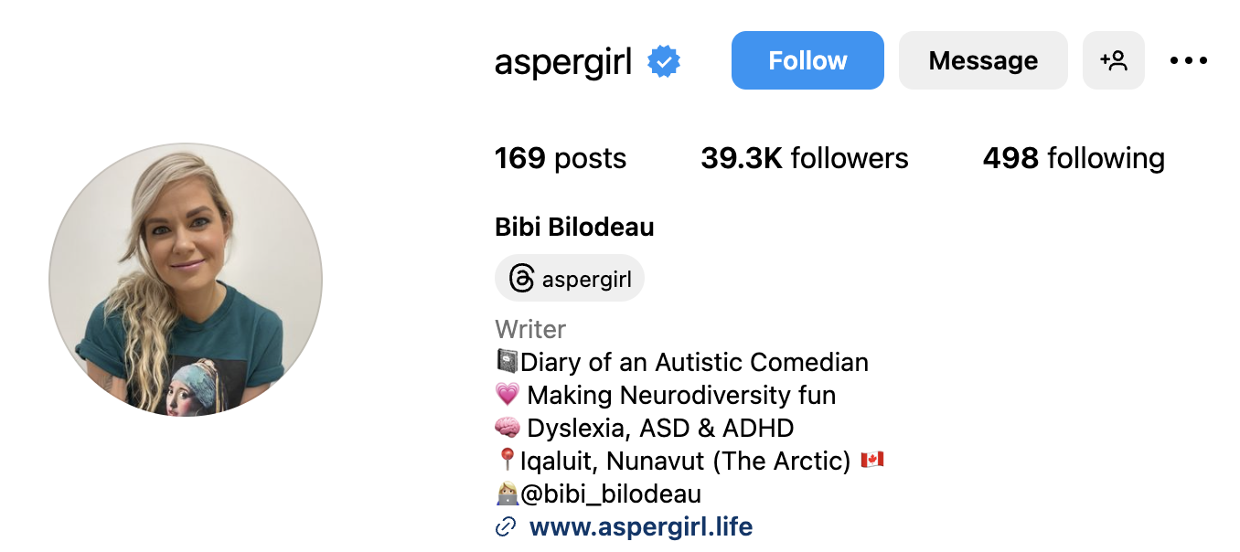
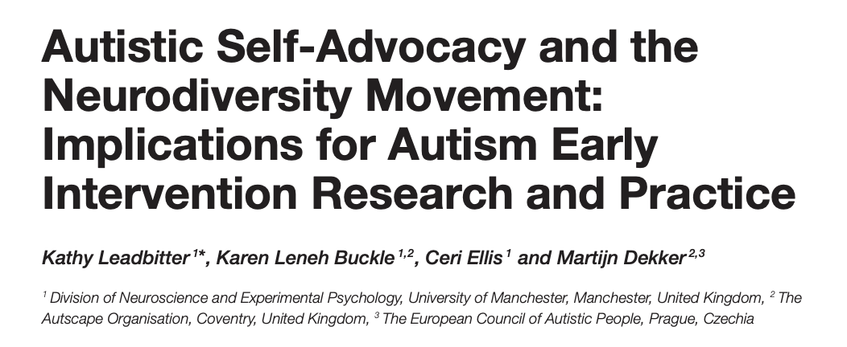
How to Stay Current
Self-advocacy and community organizations
Self-advocates
Academic publications
Literature
Notes:
In the social model of disability, people living with a condition are the experts in that condition. In addition to academic publications, self-advocates are often great sources for up-to-date language recommendations when working with neurodiverse families and individuals.

Slide 15
DIAGNOSTIC ODYSSEY:
FROM DIAGNOSIS TO SERVICES

Slide 16
Diagnostic Odyssey
Traditional
1 in 6 (17%) of children aged 3-17 will be diagnosed with a developmental disability
Various etiologies
Neonatal and perinatal factors
Maternal diabetes
Neonatal injuries
Hypoxic brain injury
Neonatal infections
Rubella, listeria
Genetic conditions
Genetics Role
NDDs exhibit extreme genetic heterogeneity, where a genetic diagnosis may or may not be possible
30% of NDDs are thought to have an underlying genetic etiology
Identified via genetic testing

Slide 17
Diagnostic Odyssey
Traditional
Depending on the etiology, the referral may be placed prior to the onset of phenotype
Known neonatal exposure → postnatal evaluation with appropriate specialists
Fetal Alcohol Spectrum Disorders (FASD)
Cytomegalovirus (CMV)
Known neonatal injury → postnatal evaluation with other appropriate specialists
Hypoxic ischemic encephalopathy
Genetic Involvement
In most cases, genetics becomes involved in patient’s care after the onset of phenotype. Clinical evaluation guides testing strategy
Assessing personal history
Pregnancy history
Neonatal history
Physical examination
Assessing family history
Known conditions or features running in the family

Slide 18
Diagnostic Odyssey - Traditional Route
Phenotypic Presentation
Well Child Exam
Referral to Developmental Pediatrician
NDD Evaluation
Referral for Additional Services
Phenotype will be different for each individual and varies for each NDD
May be apparent in utero, neonatal time period, childhood, or adolescence, adulthood
Caregiver recognizes difference in development or behavior which prompts an evaluation by their pediatrician/PCP
Discussion between caregiver and provider about caregiver’s concerns
Referral made to developmental pediatrician and/or other specialist for formal evaluation
This may include:
Detailed neurological examination
Standardized assessments (i.e. ADOS for ASD)
Speciality specific assessment
Laboratory work-up
If a diagnosis is rendered, referral to appropriate services. Utilizing patient’s age to help guide resources, services, and support
Early intervention services
Supportive therapies
The ARC of Virginia
CCC Plus Waiver

Slide 19
Diagnostic Odyssey - Traditional Route
Phenotypic Presentation
Well Child Exam
Referral to Developmental Pediatrician
NDD Evaluation
Referral for Additional Services
Phenotype will be different for each individual and varies for each NDD
May be apparent in utero, neonatal time period, childhood, or adolescence, adulthood
Caregiver recognizes difference in development or behavior which prompts an evaluation by their pediatrician/PCP
Discussion between caregiver and provider about caregiver’s concerns
Referral made to developmental pediatrician and/or other specialist for formal evaluation
This may include:
Detailed neurological examination
Standardized assessments (i.e. ADOS for ASD)
Speciality specific assessment
Laboratory work-up
A clinical diagnosis of some NDDs, including autism spectrum disorder, warrant a referral for a genetics evaluation
Clinical examination by geneticist
Genetic testing to identify potential etiology

Slide 20
Diagnostic Odyssey - Genetics Role
Phenotypic Presentation
Referral to Genetics
Genetics Exam + Evaluation
Genetic Diagnosis
Referral to Additional Providers
Patient presents with the phenotype to pediatrician, PCP, and/or other specialty
Specialty-specific evaluation, where the provider is suspicious of genetic etiology based on examination
Patient is referred for a genetics evaluation and based on phenotype, they either are seen in:
General Setting
Cancer Setting
Prenatal Setting
Majority would likely be seen in a general setting by a genetic counselor and a geneticist
Genetics exam would consist of:
Review of personal medical history and family history
Physical examination by geneticist
Discussion of the genetics of NDDs with an assessment of clinical findings
Based on the patient’s phenotype and indication, genetic testing will be offered to the patient
Testing may include:
Chromosomal microarray
Whole exome sequencing
Targeted gene panels
Based on the genetic condition or identified pathogenic variant, the genetics team would identify the appropriate specialties the patient should be seen by
This may include:
Ophthalmology
Neurology
PM&R
Endocrinology
Dietician

Slide 21
Diagnostic Odyssey - Genetics Role
Referral to Additional Providers
Developmental Pediatrician for NDD Evaluation
Referral for Additional Services
Based on the genetic condition or identified pathogenic variant, the genetics team would identify the appropriate specialties the patient should be seen by
This may include:
Ophthalmology
Neurology
PM&R
Endocrinology
Dietician
If genetic condition has been associated with NDD’s, the genetics team will place a referral to a developmental pediatrician for a formal evaluation and to establish care
A referral to appropriate service(s) will be made utilizing patient’s age to help guide resources, services, and support
Early intervention services
Physical therapy, occupational therapy, feeding clinic, speech therapy
The ARC of Virginia
CCC Plus Waiver

Slide 22
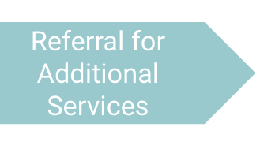
Importance of Identification for Additional Services
Goals For Children
Goals For Families
To enable young children to be active and successful participants in the early childhood years and in the future in a variety of settings
To enable families to provide care for their child and have the resources they need to participate in their own desired family and community activities

Slide 23
Importance of Identification for Additional Services: Early Intervention Services
Children identified with developmental delays from birth to 3-years-old qualify for early intervention services
Services and support on the state level to address the needs of children with developmental delays
Therapies: Physical, occupational, speech, feeding
At-home therapies
Provide services at free or reduced cost
Can significantly impact the outcomes of children and allows them to catch up developmentally with their peers and improve long-term outcomes

Slide 24
Importance of Identification for Additional Services: Part B - Special Education
In order to qualify for Part B:
There must be an educational impact
Meet criteria for eligibility in one of 14 disability categories
Specific learning disability
Dyslexia
Emotional disturbance
Obsessive compulsive disorder (OCD)
Speech or language impairment
Deafness
Intellectual disability
Down Syndrome
Autism Spectrum Disorder (ASD)

Slide 25
Importance of Identification for Additional Services: Part B - Special Education
While a clinical diagnosis may be helpful in getting this service, it does not guarantee Part B services
As providers, we can advocate for these services on our patient’s behalf by:
Outlining why these services are imperative to the patient
Letter of medical necessity
Medical necessity form
Reaching out via phone call
Utilizing nurse navigators and social workers
Medical Legal Partnership

Slide 26
NEURODIVERSITY IN THE CLINIC

Slide 27
Genetic conditions associated with neurodiversity
Monogenic conditions
Chromosomal conditions
Microdeletion syndromes
Metabolic disorders

Slide 28
Monogenic Conditions
Fragile X Syndrome
PTEN Hamartoma Tumor Syndrome
MECP2-Related Disorders

Slide 29
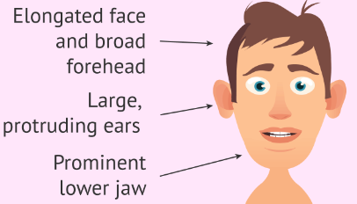
Fragile X Syndrome
X-linked disorder – over 200 triplet repeats in the FMR1 gene
Population incidence of 1 in 4,000 males
Phenotype includes ID, ASD, characteristic facial features, and macroorchidism
1 in 5 will have ASD
Causes 0.5 – 2% of ASD
Carrier females may experience premature ovarian failure (20%) and adult-onset ataxia
Photo credit: https://www.invitra.com/en/fragile-x-syndrome/physical-traits-x-fragile/
Notes:
Carrier females may experience premature ovarian failure (20%) - as early as age 11, increased risk of infertility and menopausal symptoms) and adult-onset ataxia

Slide 30
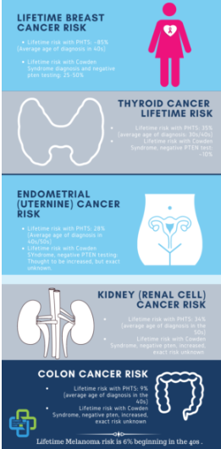
PTEN Hamartoma Tumor Syndrome
Spectrum of disorders including Cowden, Bannayan-Riley-Ruvalcaba, and Proteus
Caused by pathogenic variants in PTEN gene.
Autosomal dominant inheritance
Increased lifetime risk of various cancers, ex: breast (67-85%), endometrial, thyroid, renal, colorectal
Characteristic macrocephaly – head circumference over 98%
Photo credit: https://ptenfoundation.org/pten-hamartoma-tumor-syndrome-awareness-day-is-oct-23/

Slide 31
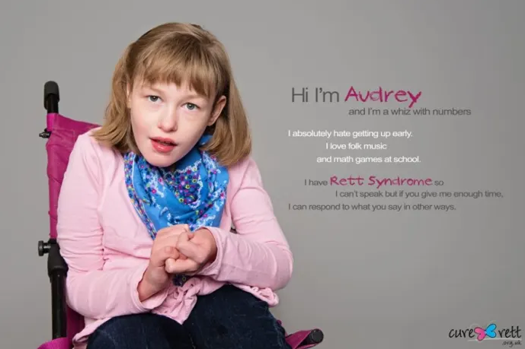
MECP-2 Related Disorders
X-linked disorders caused by pathogenic variants in MECP2 gene
Rett Syndrome is classic form
Females severely affected (prevalence: 1 in 10k-15k); mostly fatal in males
Phenotype includes regression, seizures, ASD, hypotonic facies, microcephaly, hand wringing
Most individuals live into 40s-50s
Atypical form of Rett can range from severe to isolated autism in males and females
Photo credit: https://discover.hubpages.com/health/Autism-for-girls-The-Disturbing-Facts-about-Rhett-Syndrome

Slide 32
Chromosomal Conditions
Down syndrome
Klinefelter Syndrome
Turner Syndrome

Slide 33
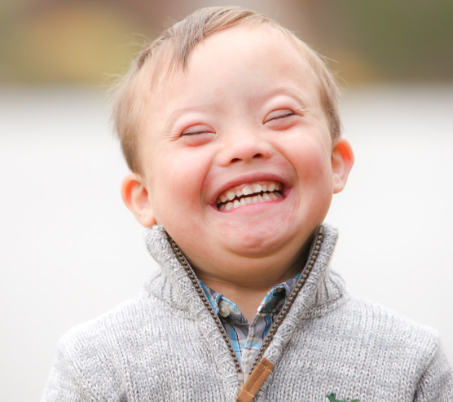
Down Syndrome
Autosomal trisomy of 21st chromosome
Phenotype includes DD, ID, heart defects, hypotonia, increased risk of leukemia, intestinal problems, and characteristic facial features
Studies vary greatly - 5 - 39% of individuals with DS have ASD; estimates vary
Photo credit: https://ndss.org/about
Notes:
Upslanting palpebral fissures, small low-set ears, protruding tongue, epicanthal folds. Also single transverse crease and gap bxn 1st and 2nd toes
https://www.ncbi.nlm.nih.gov/pmc/articles/PMC9979529/

Slide 34
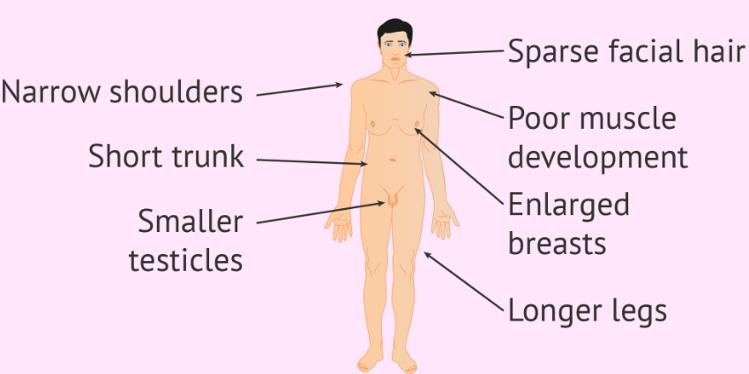
Klinefelter Syndrome
Male with trisomy of sex chromosomes – XXY
Phenotype includes tall stature, long arms and legs, short trunk, breast development, sparse pubic hair, testicular atrophy, infertility, behavioral disorders including ADHD
ASD about 4x more likely than population risk (and 20x more likely for those XYY genotype, an unrelated condition)
Photo credit: https://www.invitra.com/en/klinefelter-syndrome/characteristics-of-klinefelter-syndrome/
Notes:
Symptoms can be subtle. Likely underdiagnosed.
https://www.ncbi.nlm.nih.gov/pmc/articles/PMC5423728/

Slide 35
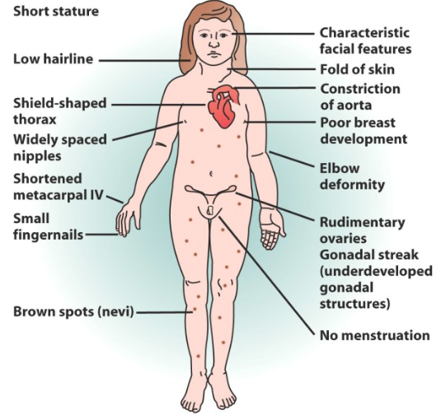
Turner Syndrome
Female with monosomy of X chromosome
Phenotype includes short stature, fold of skin behind the neck, high risk for cardiac defect, poor breast development, nevi, lack of menstruation
ASD four times more likely than in the general population and psychiatric manifestations twice as likely
Notes:
https://www.ncbi.nlm.nih.gov/pmc/articles/PMC8554886/

Slide 36
Microdeletions and Microduplications
22q11.2 (DiGeorge Syndrome)
Williams Syndrome
Chromosomal Hotspots

Slide 37
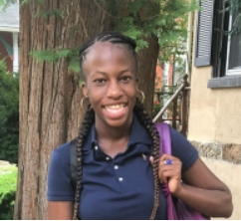
Microdeletions and Microduplications
22q11.2 Deletion Syndrome (DiGeorge)
DD, ID, immune deficiencies, palate abnormalities, CHD, hypoparathyroidism, feeding difficulties, psychiatric disorders
1 in 2,000 to 4,000 births
15-50% have ASD or ASD-related phenotype
Photo credit: https://www.chop.edu/stories/22q112-deletion-syndrome-jasmines-story
Notes:
DiGeorge: long face, hooded eyelids, short philtrum, hypernasal speech.
22q11.2 duplication also known to cause neurodivergence including ADHD and aggressive behavior
Williams: broad forehead, bitemporal narrowing, periorbital fullness, strabismus, short nose, broad nasal tip, malar flattening, long philtrum, thick vermilion of the upper and lower lips, wide mouth, malocclusion, small jaw, and large earlobes
https://www.ncbi.nlm.nih.gov/pmc/articles/PMC5454981/

Slide 38
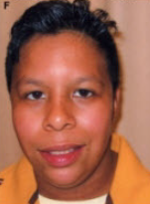
Microdeletions and Microduplications
Williams Syndrome (7q11.23 deletion)
DD, mild ID, cardiovascular disease, growth deficiency, endocrine abnormalities, distinct facial features, and severe impairment of visuospatial construction
Neurobehavioral: 95% have challenges with emotional regulation and “overly friendly” personality, 80% have anxiety, 65% have ADHD, 10-20% have ASD
Photo credit: https://www.ncbi.nlm.nih.gov/books/NBK1249/figure/williams.F2/?report=objectonly
Notes:
DiGeorge: long face, hooded eyelids, short philtrum, hypernasal speech.
22q11.2 duplication also known to cause neurodivergence including ADHD and aggressive behavior
Williams: broad forehead, bitemporal narrowing, periorbital fullness, strabismus, short nose, broad nasal tip, malar flattening, long philtrum, thick vermilion of the upper and lower lips, wide mouth, malocclusion, small jaw, and large earlobes
https://www.ncbi.nlm.nih.gov/pmc/articles/PMC5454981/

Slide 39
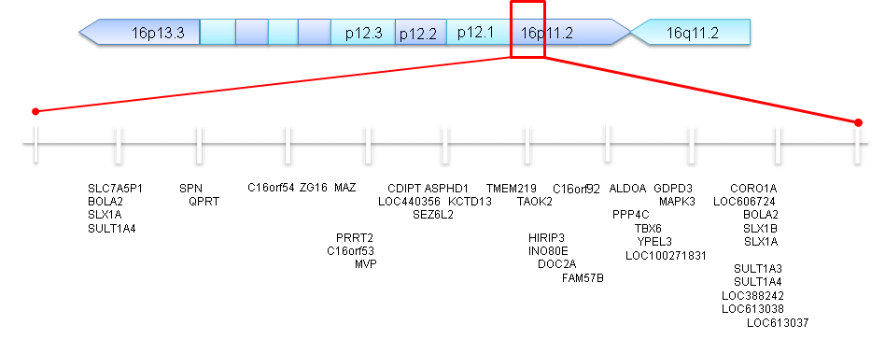
Microdeletions and Microduplications
Chromosome 15 and 16 hotspots
Known to lead to ASD
Ex: 16p11.2 causes 0.5 - 1% of ASD
Other phenotype often includes ID, DD, and psychiatric issues
Photo credit: https://www.simonssearchlight.org/research/what-we-study/16p11-2-deletion/
Notes:
DiGeorge: long face, hooded eyelids, short philtrum, hypernasal speech.
22q11.2 duplication also known to cause neurodivergence including ADHD and aggressive behavior
https://www.ncbi.nlm.nih.gov/pmc/articles/PMC5454981/

Slide 40
Metabolic Disorders
Phenylketonuria (PKU)
Many more

Slide 41
Phenylketonuria (PKU)
Due to pathogenic variant in PAH gene. Autosomal recessive inheritance
Patients cannot metabolize phenylalanine
If untreated (before ubiquity of NBS), phenotype includes ID, autistic-like features, Parkinson-like features, epilepsy, decreased skin/hair pigmentation, and musty body odor
Even with treatment, various neuropsych issues are common
Notes:
On NBS so rarely see untreated features anymore
Maternal PKU - uncontrolled PKU during pregnancy can affect the baby, Can result in ID, microcephaly, CHD, IUGR, low birth weight, spontaneous abortion, etc.
Neuropsych issues: OCD, psychosis, anxiety, depression. Adherence to diet is a factor.

Slide 42
Many more metabolic disorders…
Many metabolic disorders include ASD. Could manifest in neuroregression, but majority have a variety of clinical features
Often treatment available, increasing clinical value of testing
Review history for additional metabolic eval
Routine metabolic testing in patients with ASD

Slide 43
Summary
Language matters
The diagnostic odyssey looks different for everyone
Genetics can alter this journey for patients
Genetics can identify other medical concerns, which can prompt a referral to services outside of NDDs
Neurodiversity can be a feature of many conditions, genetic or otherwise
As clinicians, we can influence the way patients view their diagnoses
We can also help connect patients with resources and supports

Slide 44
Discussion Points

Slide 45
Discussion Points

