Slide 1
Intersectionality of
Blindness
and
Neurodivergence
Dawn Snow

Slide 2
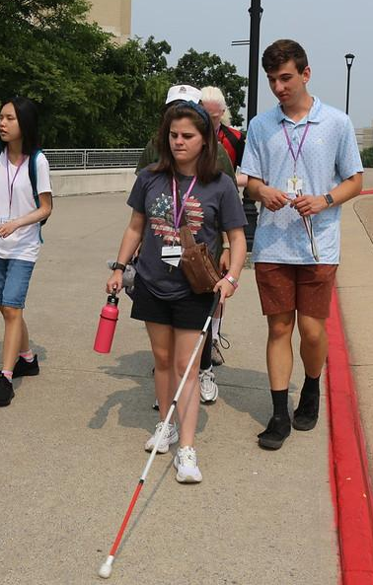
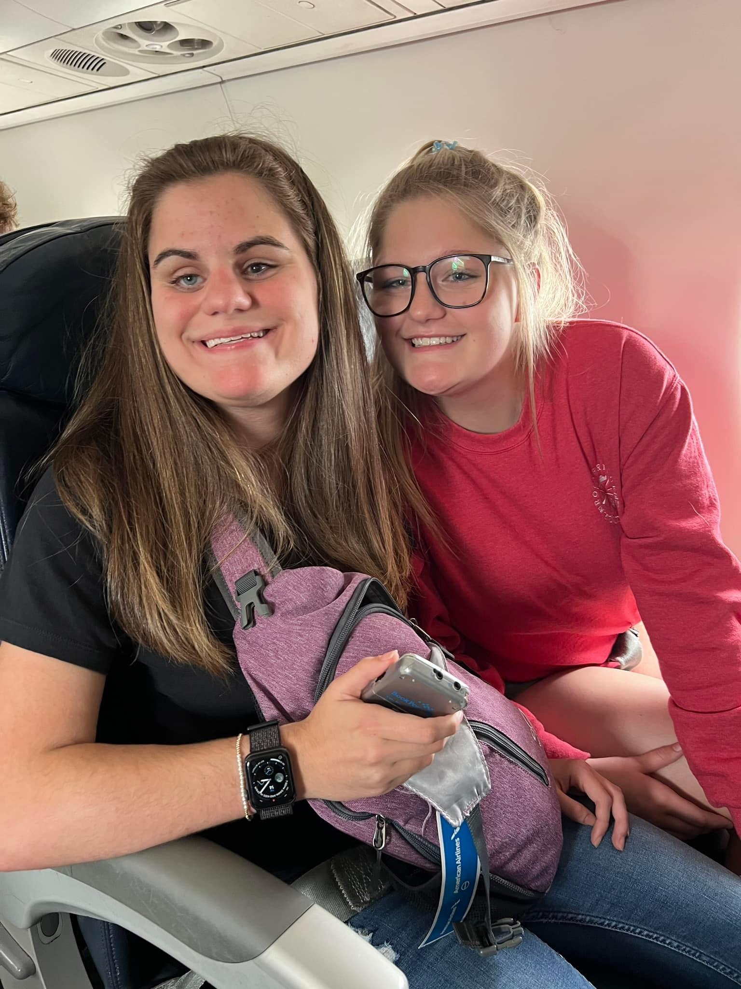
Project Motivation
My Girls
Observations
Experiences shared by students and families
Personal Experiences
Violation of civil liberties
Notes:
My motivation for this project has been a combination of things. Over the past 22 years both a parent and as a family support coordinator working with families who have a loved one who has vision loss including blindness, I have observed trends within the blind community. Specifically with the state department for the blind and with training centers run by blind organizations. The trend that I have observed has been to exclude students with additional disabilities from their programs. Or when included not allowing for needed supports, pushing and shaming students, sometimes causing lasting negative impacts on students. Personally, my daughter who is blind and neurodivergent has been deterred from participating in camps and much needed skill building programs because of some of her support needs. What led to my final decision for this project was a situation that happened last summer where she attempted to participate in a week long college immersion experience with our state department for the blind. I was able to talk the staff into allowing me to scaffold in some light support in the early morning and late night as well as to ease her anxiety of being there. She was doing great until the 3rd and 4th day in. Unfortunately staff would not allow her to take a break when she asked for one due to her feet and hips hurting, A staff person fussed at her for using one of her accommodations (audio recording a presentation). Then the next day fussed at her to hurry up and find her way to the bus (as everyone else had already made it there), when she requested help the staff person refused and instructed her to try to figure it out, while also rushing her. Eventually exclaiming that she was “extra”. Later that same day staff took her purse from her without her permission, because they thought she might use her audio recorder (which again, is an accommodation and had been listed as such). What should have been an experience of learning new skills in a supportive environment turned into a humiliating experience. Needless to say I removed her from the program that day.

Slide 3
PROJECT
Part I:
Establish a focus group
Establish a community of support
Identify areas of need
Part II:
Continue Community of Support
Create Video Series
Lived experiences
Resources
Notes:
This project will have two parts. I am focusing on part one.
To better understand these concerns, I conducted focus groups with youth and young adults who are blind and are neurodivergent to explore their experiences. As a result of these discussions, the youth decided to establish monthly community of support meetings, which will enable them to have a safe space, feel a sense of community, share their lived experiences and decide on topics that they identify as areas of need to raise awareness around.
My daughter Kim and a fellow LEND trainee will be doing the second part which is to continue the community of support, create a video series presented by youth with lived experiences and based on what is identified as being areas of need and resources.

Slide 4
Prevalence
“the relationship between autism and visual impairment is a close relationship;
Data from epidemiological studies show that there are some causes of total and partial blindness that have a closer relationship with ASD:
retinopathy of prematurity (ROP),
Leber’s amaurosis,
optic nerve hypoplasia,
septo-optic nerve dysplasia,
micro-ophthalmia,
anophthalmia, and
CHARGE syndrome”
More research needed
(Pili R, 2021)
Notes:
I have observed so much over the last 22 years so it was really helpful to identify actual studies and reports supporting this. One thing that is commonly understood in the blindness community is that the majority of students who are blind or visually impaired have additional disabilities. Another is what the blind community often referred to as “blindisms” but what others know as neurodivergent traits.
I was highly discouraged by professionals in the blindness fields from seeking an autism evaluation for my daughter when she was younger. So I was thrilled to see that there have been some studies. The most recent shows that there is a close relationship between autism and congenital visual impairments.

Slide 5
Prevalence Cont.
Approx. 50% of VA’s students with visual impairments have at least one coexisting disability. : (Virginia Department of Education, 2017)
50-75% of children with visual impairments have additional disabilities. (Silberman, 2000)
Professional estimate at least 50% of students with visual impairments have additional disabilities and are not identified as having a visual impairment. There are differences between the Child Count and states’ total population counts.
(Schles, 2021)
Often not captured in data counts as having a visual impairment:
Students with visual impairments that have more complex needs are often identified as multiple disabilities.
Students who are identified as Deafblind have a separate data count.
Notes:
The 2021 study was developed to update available data regarding students with visual impairments and identify how data informs educational decisions and supports for these students. Survey results indicated a statistically significant difference between Child Count and total population reports of students with visual impairments during the 2016–2017 school year. Furthermore, the differences between these numbers affected the ability of practitioners to plan for and support students with visual impairments. They went on to note that Understanding the available population data for students with visual impairments is key for practitioners, administrators, and policy makers to make informed decisions to support students with visual impairments.

Slide 6
Excluded from VR and Pre-ets
Observation: VA’s Pre-ets and VR for the blind seem to focus on students who are blind without additional disabilities or support needs.
Observation: Many students that participate have residual vision.
Data reflect:
2020 Study on VR Data about People with Visual Impairments:
“Virginia has the lowest rates of additional impairments,”
6.8% “Priority of the disabling conditions qualifying the participant for services. In particular, the proportion of individuals in the data who are labeled with a “most significant disability”
(C. M. Clapp, 2020)
Notes:
So if we know that possibly between 50-75% of students have additional disabilities then why are Virginias VR agency’s numbers so low? I have observed over the last 22 years how our state department for the blind excludes students with additional support needs from many of their programs. This has significantly limited, almost to the point of complete exclusion, the ability of the largest population of student who are blind for accessing pre-ets and cov rehab programs for the blind. In a 2020 study on the Overview of Vocational Rehabilitation Data about People with Visual Impairments it was noted that Virginia has the lowest rates of clients with additional impairments other than vision loss. It also noted that the priority of disabling conditions qualifying the participant for services that the people labeled as having the most significant disability was very small. The Study also mentioned how the agencies are pressured to show good ROI with the clients they serve. So could this be why DBVI is so selective, to enable them to show higher success rates? But where does that leave our students who could benefit the most from Pre-ets and VR programs?

Slide 7
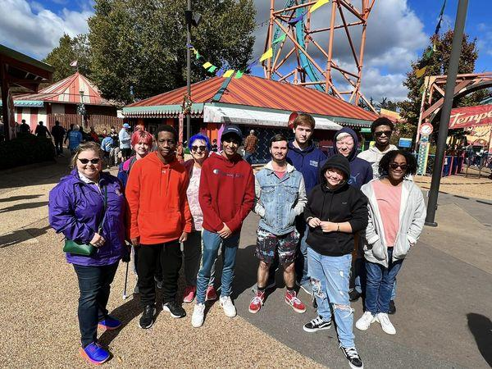
Excluded from VR
Past:
Staff hand selected which students notified of opportunities.
Current:
screening applicants for pre-ets programs. (Impaired D. f., 2024)
Non flexible criteria for VR LIFE program. Required to be independent in all self care. (Impaired V. R., 2024)
Notes:
So if we know that possibly between 50-75% of students have additional disabilities then why are Virginias VR agency’s numbers so low? I have observed over the last 22 years how our state department for the blind excludes students with additional support needs from many of their programs. This has significantly limited, almost to the point of complete exclusion, the ability of the largest population of student who are blind for accessing pre-ets and cov rehab programs for the blind. In a 2020 study on the Overview of Vocational Rehabilitation Data about People with Visual Impairments it was noted that Virginia has the lowest rates of clients with additional impairments other than vision loss. It also noted that the priority of disabling conditions qualifying the participant for services that the people labeled as having the most significant disability was very small. The Study also mentioned how the agencies are pressured to show good ROI with the clients they serve. So could this be why DBVI is so selective, to enable them to show higher success rates? But where does that leave our students who could benefit the most from Pre-ets and VR programs?

Slide 8
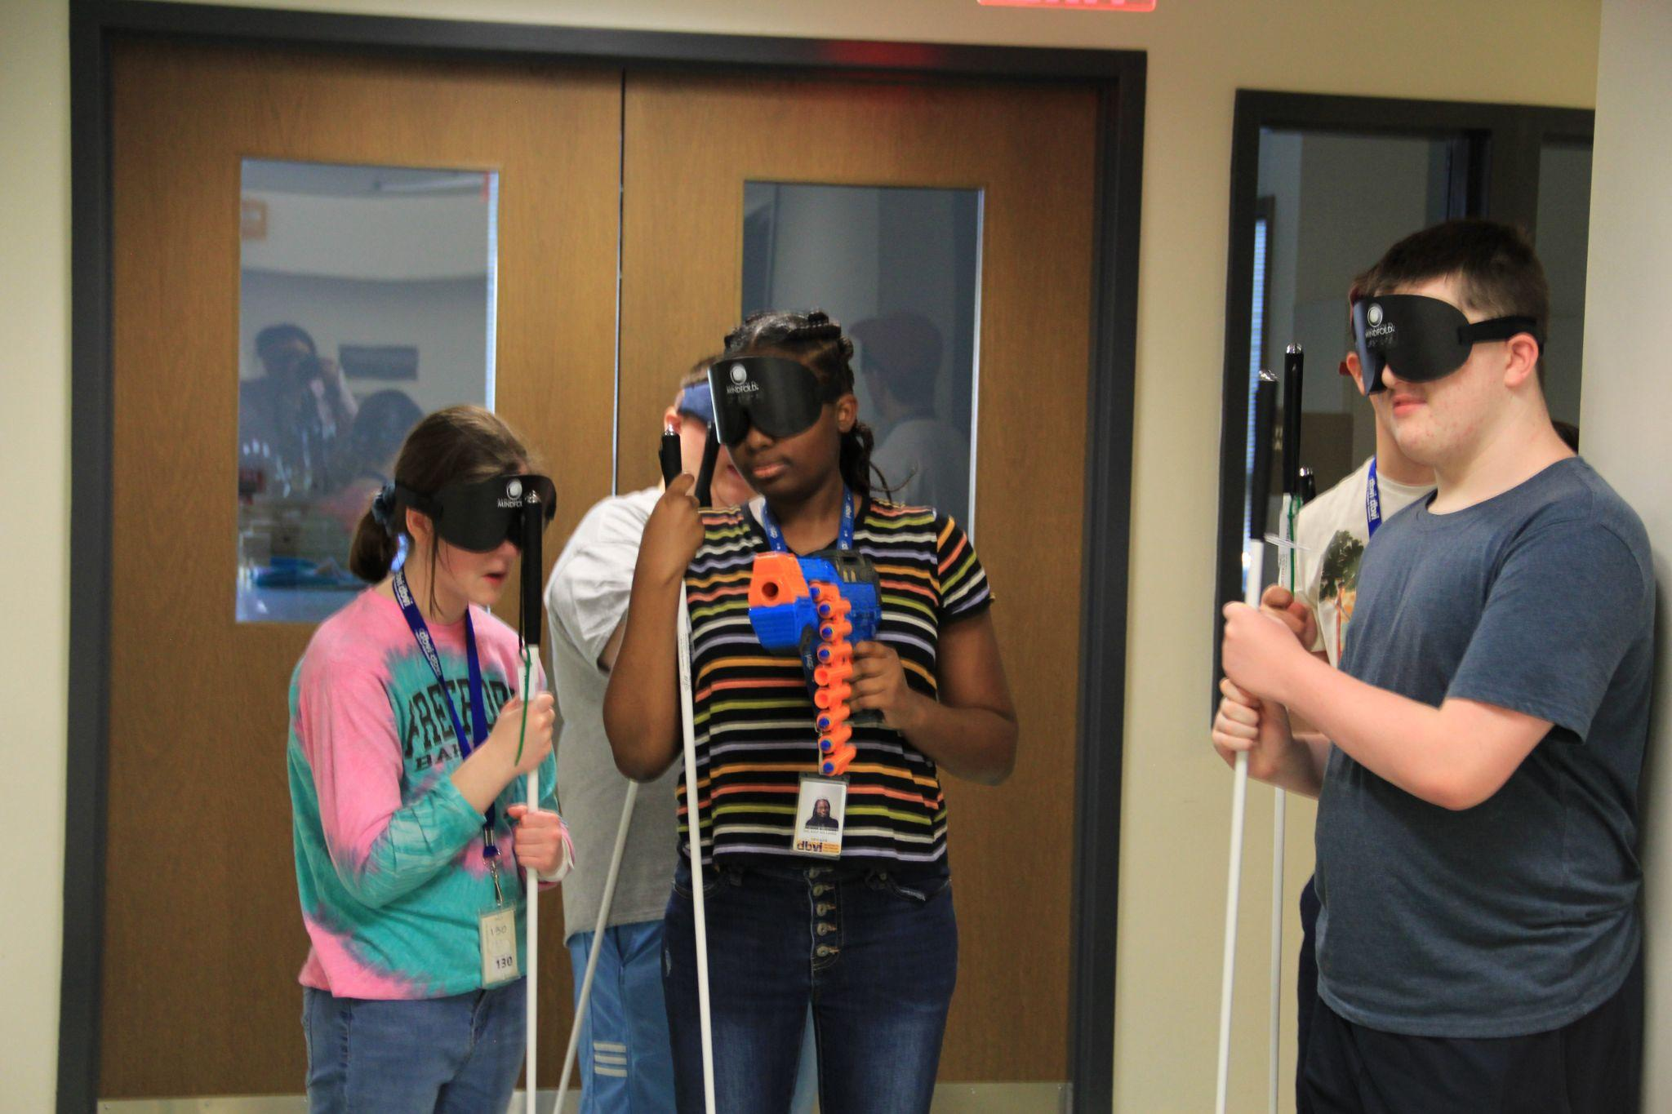
Excluded from VR and Training Centers
Reported by families and students:
Inflexible - Not person centered
No exceptions to residential
Sleep Shades
Different Cane
Structured Discovery Method (with minimal structure) (Board, 2008-2024)
Other Points to consider:
Surveys are not utilized (Chaz Compton, 2022)
Concern/Complaint form or procedures not easily available
Notes:
DBVI’s programs run by their Rehab center are supposed to help teach blindness skills and advocacy, experience variety of recreation activities and get work experiences. But they are inflexible about students having to stay for the entire residential program, not allowed to bring a PCA, must be independent in all self care and medications. Additionally all students are forced to use a NFB cane, and wear sleep shades for all instructional activities. This includes O&M, which involves learning to orient and navigate the building, sidewalks and streets, cooking, grilling and much more. Parents have shared these are some of the reasons they decided not to send their child, others have shared that their child was kicked out of the program because he couldn’t handle it. Students have shared that they decided not to go back because of the anxiety and panic they experienced while feeling pushed to do things they were not comfortable with while wearing sleep shades. Students have shared how staff and other students made hurtful comments, and they felt shamed. These similar experiences occur at training centers run by blind organizaations around the country.

Slide 9
Quotes From Focus Group
“I wish they would be more flexible.” - M.M.
“They need to truly listen and learn from the youth.”-M.W.
“Staff needs to work on their emotional intelligence.” -M.W.
“Don’t yell at or humiliate us, be supportive.” - L.H.
“There are different levels of independence and what works for one might not be right for another.” - K.D.
“We are individuals with different needs and preferences.” - B.P.
“What would they do if a blindness program said you couldn’t bring your cane? It is no different. A cane is a needed support just like a PCA is a needed support. It is a double standard.” -B.F.

Slide 10
Project HOPES - GOALS
Raise awareness
Change in attitudes
Normalize neurodiversity within the blind community & professionals
Increase family/student advocacy
Encourage agencies and organizations to implement trainings
Inclusion
Neurodiversity
Trauma Informed Care
Person Centered Practices
Impact how agencies and organizations support students.

Slide 11
References
Board, N. B. (2008-2024). What is Structured Discovery. Retrieved from National Blindness Professionals Certification Board: https://www.nbpcb.org/pages/what-is-structured-discovery.php#:~:text=SDCT%20is%20now%20a%20unique,learning%2C%20and%20confidence%20building%20experiences.
C. M. Clapp, J. V. (2020). Overview of Vocational Rehabilitation Data about People with Visual Impairments: Demographics, Services, and Long-Run Labor Market Trends. Journal of Visual Impairments & Blindness, 114(1), 43-56.
Chaz Compton, M. K. (2022). Comprehensive Statewide Needs Assessment Report, Commonwealth of Virginia Department for the Blind and Vision Impaired and The State Rehabilitation Council. The Interwork Institute at San Diego State University.
Impaired, D. f. (2024). Universal Application. Retrieved from Department for the Blind and Visually Impaired: https://www.nbpcb.org/pages/what-is-structured-discovery.php#:~:text=SDCT%20is%20now%20a%20unique,learning%2C%20and%20confidence%20building%20experiences
Impaired, V. R. (2024). Youth & Other Programs. Retrieved from Virginia Rehabilitation Center for the Blind and Visually Impaired: https://www.vrcbvi.virginia.gov/programs.htm#LIFE

Slide 12
References Cont.
Pili R, Z. B. (2021). Autism and Visual impairment: A First Approach to a Complex Relationship. Clin Pract Epidemiol Ment Health, 17:212-216.
Schles, R. A. (2021). Population Data for Students with Visual Impairments in the United States. Journal of Visual Impairment & Blindness,115(3), 177-189.
Silberman, R. K. (2000). In A. J. M. Cay Holbrook, Foundations of Education Vol. I History and Theory of Teaching Children and Youths with Visual Impairments, (pp. 173–196). New York: American Foundation for the Blind. Retrieved from https://ies.ed.gov/ncser/pubs/20083007/#:~:text=Data%20on%20the%20prevalence%20of,additional%20disabilities%20(Silberman%202000)
Virginia Department of Education, D. o. (2017). Guidelines for Working with Students Who are Blind or Visually Impaired In Virginia Public Schools. VA, USA.

